Slide 1
BCP-DRP-IRP – “P” Is for Plan
Do you OODA?
Building and improving an Incident Response Plan
ISACA-KM
March 20, 2019
Ken M. Shaurette
CISSP, CISA, CISM, CRISC, IAM
FIPCO Director InfoSec and Audit
kshaurette@fipco.com, 608-441-1251

Slide 2

2019 Special Olympics Polar Plunge - missed February 23 in Wausau

Slide 3
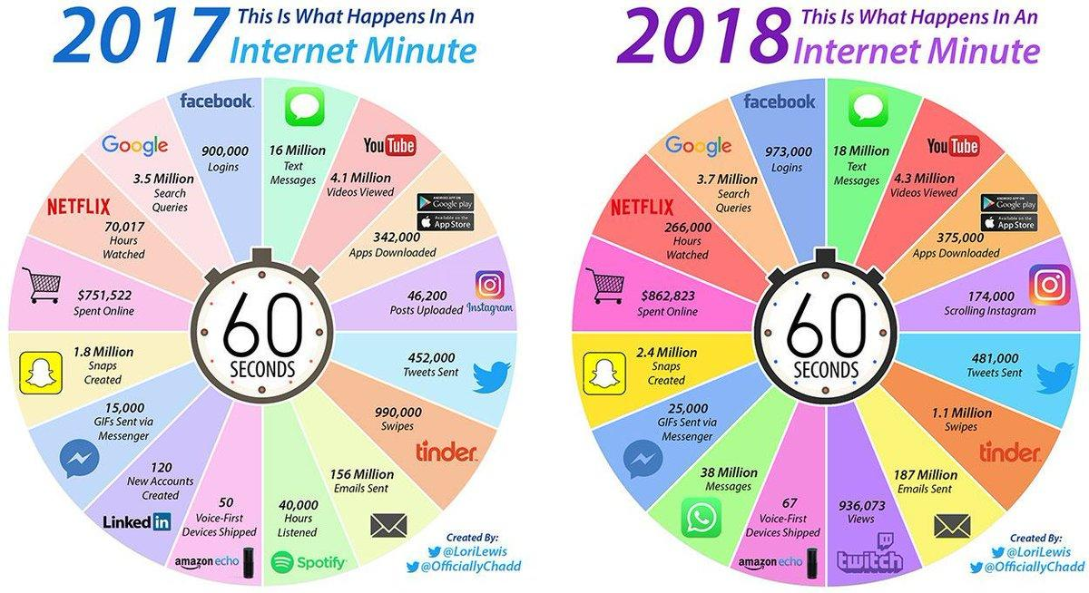

Slide 4
Objectives
Identify the major components an IRP.
Understand the incident handling lifecycle.
Basic Policy versus an IRP (the plan).
Why report Events?
Introduce OODA!
Use OODA to improve controls and plan.
Ties to DRP/BCP.

Slide 5
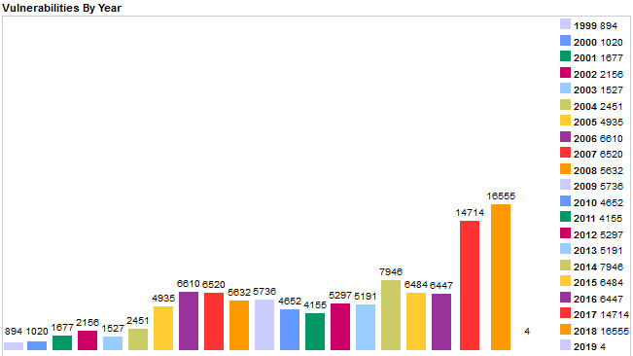
Is a Vulnerability an Incident?
https://www.cvedetails.com/browse-by-date.php

Slide 6
Cisco 2018 Annual Cybersecurity Report
Cost of attacks is no longer hypothetical.
More than half of all breaches resulted in financial damages of more than $500,000.

Slide 7
How/What do you Handle?
Computer Crimes
Viruses
Policy violations
Accidents
Stolen Laptop
Alert / Warnings
Theft of Proprietary Information
System Failure
Hacker Intrusion
Lost Backup Tape
Fire!
Customer Calls

Slide 8
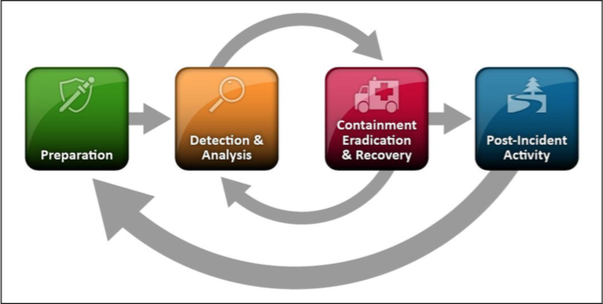
“NIST Incident Response” NIST SP 800-61
Notes:
plan out an Incident Response process
relevant documentation
even setting up a "war room”
August 2012 - Hasn’t moved on
“Use Internet Search Engines for Research”
One singular process

Slide 9

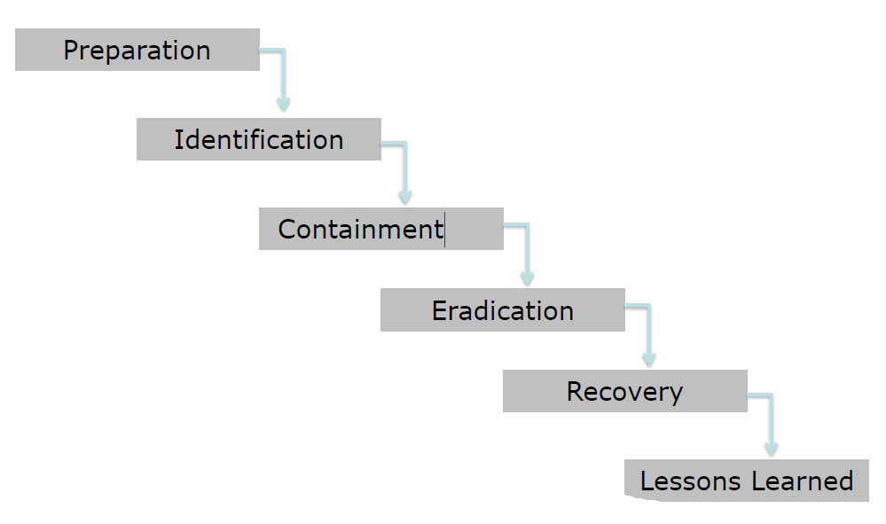



Cyber Incident Lifecycle
(Expanded)

Slide 10
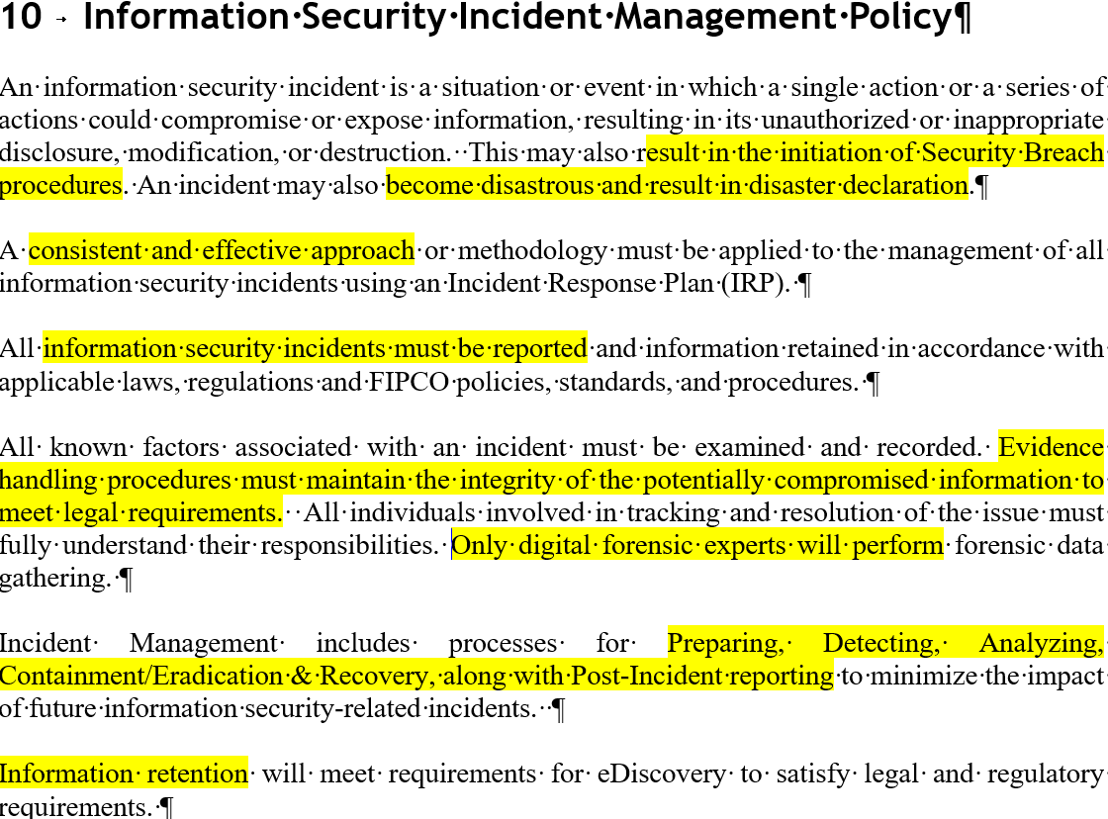
Preparation

Slide 11
Roles and Responsibility
The IRT will be led by an IRT Coordinator (or alternate) (IRC). The IRT will be brought together on an incident by incident basis appropriate to the incident and will consist of appropriate staff from within the bank. This group will form the incident team appropriate for handling each specific incident.
Minimize number of people initially involved in case of internal crime situation.
The (NAME POSITION) will be assigned the role of the IRC with the (NAME POSITION) as their alternate.
Preparation

Slide 12
The Rest is the IRP –The Plan!
The Plan does not need to be Board approved before used. That includes the DRP/BCP!
It’s NOT just Security Breach!!!!

Slide 13
Initial Analysis
The initial source from where an Incident is identified is immaterial. Potential Incidents can be reported from a variety of sources. A key source for detection of unusual behavior will be our activity tracking and behavior analytics tool, AristotleInsight. The following list is not all-inclusive, but contains some potential means of identifying Incidents:
    Alert or alerts from intrusion detection and monitoring tools
    Advanced Persistent Threats (APT)
    Use of Privileged Access that do not match to Change MGMT
    Use of Inappropriate keywords or phrases
    Log files from systems, servers, firewalls, or other equipment
    ….
Identification

Slide 14
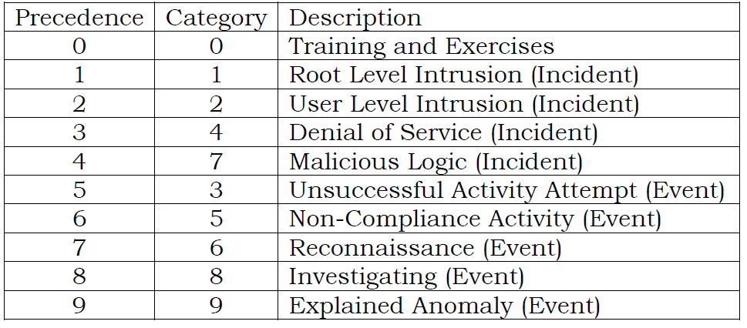
Identification
Incident Classification
http://www.jcs.mil/Portals/36/Documents/Library/Manuals/m651001.pdf?ver=2016-02-05-175710-897
Notes:
For instance, an incident could be reported either as a User Level
Intrusion (Category 2) or a Non-Compliance Event (Category 5). The User Level
Intrusion takes precedence based on Table B-A-1, and the incident should be
reported as a User Level Intrusion (Category 2) incident.

Slide 15
Identification
Incident Classification
0 | Training and Exercises—Operations performed for training purposes and support.
1 | Root Level Intrusion (Incident)—Unauthorized privileged access. Privileged access, often referred to as administrative or root access, provides unrestricted access. This category includes unauthorized access to information or unauthorized access to account credentials that could be used to perform administrative functions (e.g., domain administrator). If system is compromised with malicious code that provides remote interactive control, it will be reported in this category.
2 | User Level Intrusion (Incident)—Unauthorized non-privileged access. Non-privileged access, often referred to as userlevel access, provides restricted access based on the privileges granted to the user. This includes unauthorized access to information or unauthorized access to account credentials that could be used to perform user functions such as accessing Web applications, Web portals, or other similar information resources. If the system is compromised with malicious code that provides remote interactive control, it will be reported in this category.

Slide 16
Incident Classification
6 | Reconnaissance (Event)—Activity that seeks to gather information used to characterize systems, applications, information networks, and users that may be useful in formulating an attack. This includes activity such as mapping information networks, system devices and applications, interconnectivity, and their users or reporting structure. This activity does not directly result in a compromise.
7 | Malicious Logic (Incident)—Installation of software designed and/or deployed by adversaries with malicious intentions for the purpose of gaining access to resources or information without the consent or knowledge of the user. This only includes malicious code that does not provide remote interactive control of the compromised system. Malicious code that has allowed interactive access should be categorized as Category 1 or Category 2 incidents, not Category 7. Interactive active access may include automated tools that establish an open channel of communications to and/or from an system.
8 | Investigating (Event)—Events that are potentially malicious or anomalous activity deemed suspicious and warrant, or are undergoing, further review. No event will be closed out as a Category 8. Category 8 will be recategorized to appropriate Category 1-7 or 9 prior to closure.
9 | Explained Anomaly (Event)—Suspicious events that after further investigation are determined to be non-malicious activity and do not fit the criteria for any other categories. This includes events such as system malfunctions and false alarms. When reporting these events, the reason for which it cannot be otherwise categorized must be clearly specified.

Slide 17
Identification
Incident Classification
3 | Unsuccessful Activity Attempt (Event)—Deliberate attempts to gain unauthorized access to a system that are defeated by normal defensive mechanisms. Attacker fails to gain access to the system (i.e., attacker attempts valid or potentially valid username and password combinations) and the activity cannot be characterized as exploratory scanning. Reporting of these events is critical for the gathering of useful effects-based metrics for commanders. Note the above CAT 3 explanation does not cover the “run-of-themill” virus that is defeated/deleted by AV software. “Run-of-themill” viruses that are defeated/deleted by AV software are not reportable events or incidents.
4 | Denial of Service (Incident)—Activity that denies, degrades, or disrupts normal functionality of a system or network.
5 | Non-Compliance Activity (Event)—Activity that potentially exposes systems to increased risk because of the action or inaction of authorized users. This includes administrative and user actions such as failure to apply security patches, connections across security domains, installation of vulnerable applications, and other breaches of existing policy. Reporting of these events is critical for the gathering of metrics.

Slide 18
Verification
Identifying an Incident may result in the need to employ a large amount of Information Security resources. …. Adhere to the following:
Assumptions - Do not assume anything.
Data Collection - Collect as much information possible
Information Gathering - Ensure a detailed description
Logging –detail log of activities, processes….. from initial alert to post-mortem of the incident
Minimize number of people initially involved
CONSIDERATIONS FOR DIGITAL FORENSICS…..
Identification

Slide 19
Communications and Coordination
Once an Incident is confirmed, the IRT Coordinator (or alternate) will distribute notifications to the necessary contact list. Note that the handling of Incidents is not necessarily improved by an increased number of people that are aware an incident has taken place.
At initiation of an Incident, the IRT Coordinator (or alternate) …… strict “Need-To-Know” policy … control communication channels. …... All notifications will be documented on an IRP Processing Log.
Insurance Carrier Notification – MAKE IT EARLY
Notification

Slide 20
Triage Phase
IRT Coordinator (or alternate) assembles the IRT staff to gather preliminary details about the Incident. The IRT Coordinator (or alternate) will activate the full IRT, this team may include all or part of the IS Committee depending on the incident and personnel needing to be involved in gathering information….
Evaluate the need to use forensic procedures. …
DECLARE DISASTER – INITIATE DR/BCP
Allocate resources and personnel to the IRT….
Possible Interviews with personnel involved….
External Org’s (Regulator, FTC, Forensics, law, legal)
Identification/Analysis

Slide 21
Depending on the severity of the event, the affected system(s) may be taken off-line until the root cause of the event is eradicated. The recommendation to remove the affected system from the network will be made by the IRT Coordinator (or alternate) and submitted to the IRT for discussion and final approval. ……
CAREFUL WITH CONTACTING LAW ENFORCEMENT
TIMING - PRIVELEGE
CONSIDER LAWYER
DO NOT REBOOT OR MAKE ANY CHANGES TO THE SYSTEM ITSELF. (FORENSICS REASONS)
Containment

Slide 22
Root Cause – Minimize Risk
.. eradication goal is to eliminate or mitigate ..the compromise of the system(s). …… cannot be fixed without an understanding of what happened, …… if ongoing tracking of a situation regarding computer use is necessary, network system logs may need to be carefully reviewed or consideration given to a more robust monitoring tool to track user and computer activity. ……
IRT will analyze all of the information gathered in an attempt to determine the method of compromise.
Vulnerability assessment
Eradication

Slide 23
Getting Back to Normal
Affected systems must be restored to their pre-incident condition. This may require rebuilding the system from a trusted backup or from scratch.
Completing the following steps will assist in the recovery process:
Reinstall and data recovery for the system.
Validate the system. ….
Harden the system …..
Decide when to restore operations. ....
Monitor the system. ….
Recovery

Slide 24
Post-Mortem
..Useful tips …. conducting the postmortem phase are:
Hold a “Lessons Learned Meeting” …successes and identify areas for improvements.
Reviewed during the post-mortem … logging ….., the overall IRP, any forms ….recap of forensic analysis, …..
Consider timeliness and adequacy ….., quality of information gained …. were staffs responsive.
Comments, opinions and insights … in report draft.
Build an Executive Summary report …. summary of the outcome …. estimated costs ..
Lessons Learned

Slide 25
Post-Mortem
..Useful tips …. conducting the postmortem phase are:
Present the Executive Summary to the Board of Directors at the next available board meeting.
Send recommended changes to management along with a cost estimate, high-level schedule, and if known the impact of implementing or not implementing any recommended actions.
Ensure that budget is adequate and approved to make the required improvement(s) and management commits to meet established timelines. This may require board level involvement.

Slide 26
IRP Standard Operating Procedures
Remain Calm
Take Valuable Notes (Documentation)
Identification
Enforce a “Need to Know” Policy
Use Out-of-Band Communications
Containment
Backup the System
Eradicate the Problem
Resume Business

Slide 27
Relationship of Phases
http://www.jcs.mil/Portals/36/Documents/Library/Manuals/m651001.pdf?ver=2016-02-05-175710-897
Post-Incident Activities
Resolution and Closure
Recovery
Eradication
System Malware and Network Analysis
Containment
Initial Response
Initial Analysis
Coordination
Reporting and Notification
Documentation
Data Acquisition and Preservation
Detection
Time
T0
T1
T2
T3
T4
T5
T6
T7
T8
T9
TD
Notes:
http://www.jcs.mil/Portals/36/Documents/Library/Manuals/m651001.pdf?ver=2016-02-05-175710-897

Slide 28
Metrics
Preferred metrics to track include
containment time, (collecting live data – remediate)
dwell time, (initial compromise – notification)
collection and analysis time, and;
detection success by tool or technique.
Another metric is time to reporting.
GDPR and the 72-hour requirement to report an incident (costly penalties)
Notes:
Organizations must ensure they are monitoring their capabilities and removing any inefficiencies that may arise. This will help ensure your organization is in compliance with guidelines and can avoid costly penalties.
The Dwell Time refers to the length of time from the initial compromise through the point of notifying affected stakeholders. The Containment Time refers to the period between collecting live response data and the eventual remediation.

Slide 29
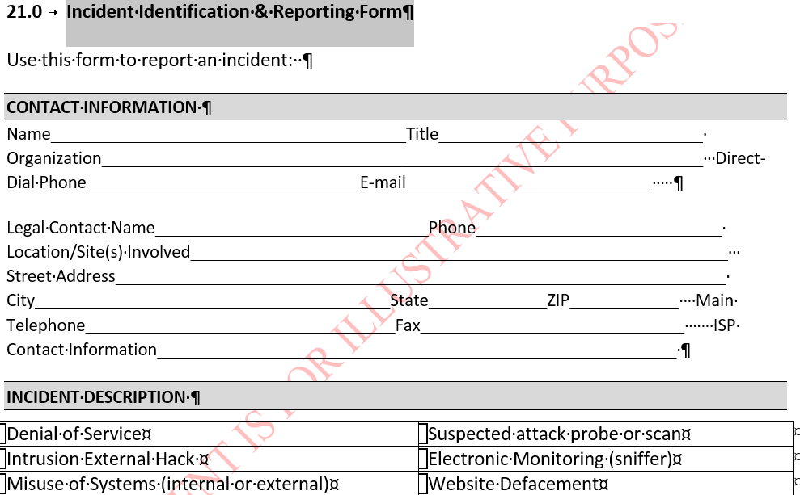
Forms to Consider

Slide 30
Forms to Consider
Model Letter for Customer Contact

Slide 31
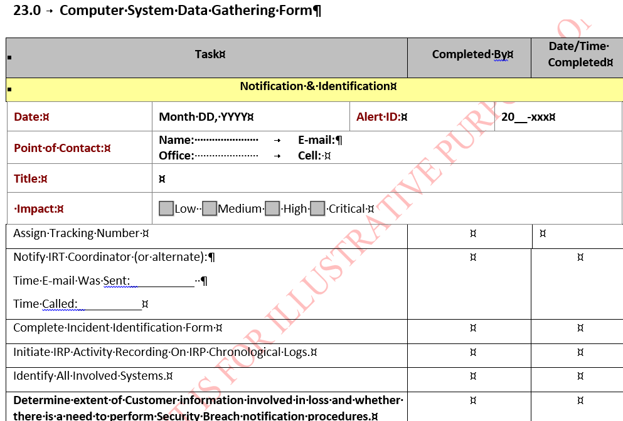
Forms to Consider

Slide 32
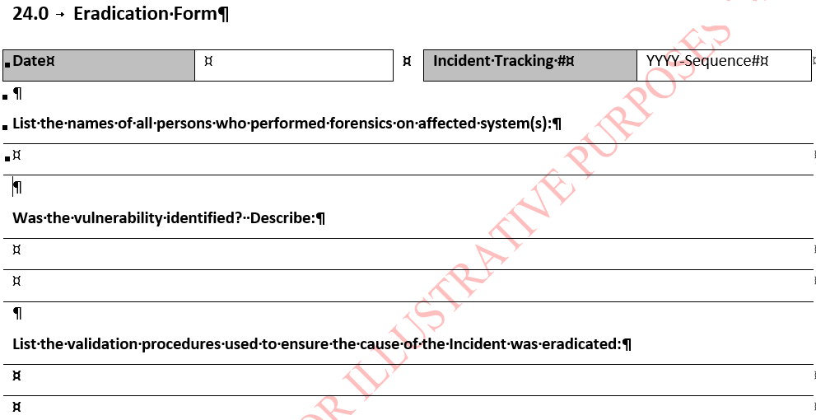
Forms to Consider

Slide 33
Forms to Consider
Evidence Logs
Checklists or types of evidence gathering are reminders of what to capture. Could include:
Photographs
Electronic media
Places where information is stored – shares, servers, workstations, paper
Processing log

Slide 34

The Attacker Can Help You Design Your Defense
Testing:
An incident handling life cycle shares similar characteristics with a business and military strategy known as the.
OODA (Observe, Orient, Decide Act)
How Can it Help?
Used to deal with human opponents, applicable to cyber security and cyber warfare.

Slide 35
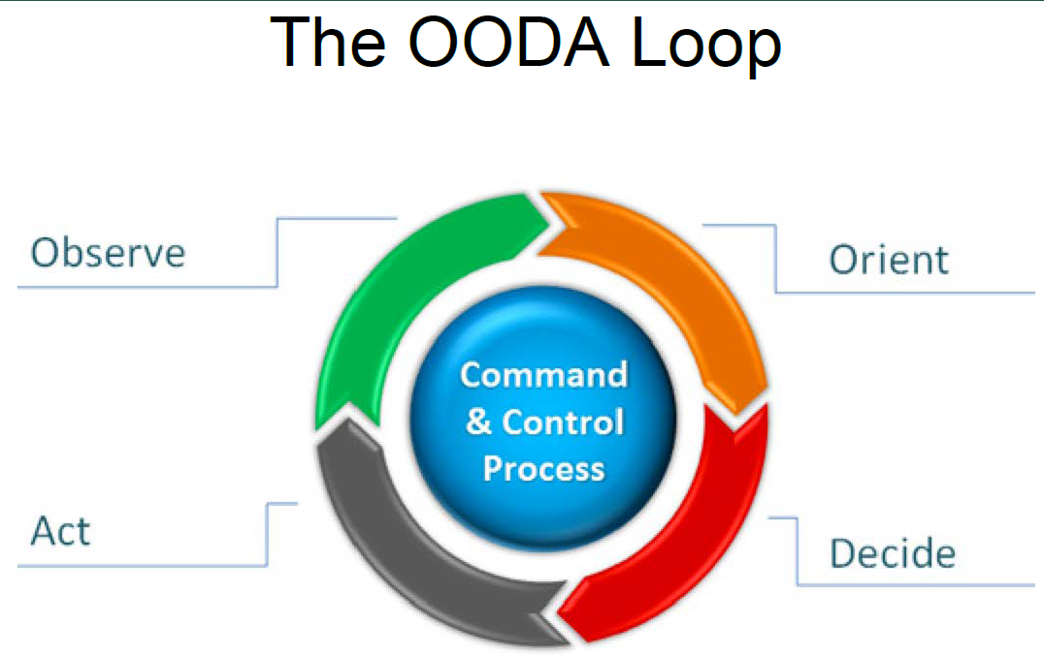
Observe, Orient, Decide, and Act Loop
Notes:
Often used for Combat Operations process, now applied to understand commercial operations and learning processes, the approach explains the agility can overcome raw power in dealing with human opponents, especially applicable to cyber security and cyber warfare.

Slide 36
OODA Loop and Incident Response
Use the OODA Loop to integrate process, technology and resources into incident response
•The OODA Loop is not a static plan but rather a way to make accurate decisions in a rapidly changing environment
The OODA Loop is not only about responding to an incident but preparing resources
Incidents are often not static but rather an evolving set of events

Slide 37
OODA - Observe
Actions
Evidence
Computer is running slow
Ransom note
Sensor alerts
Wordpress site is compromised to host malicious links
Network logs
Modified Files
Third party notices
A username and password is stolen to send spam
Detection
Data
A user visits a malicious page and malware is installed
Information
Large amount of sent e-mails
Large amount of bounce backs
Attacker
Attack
Signature
Resources
Notes:
remember we talked about data and resources, attacker actions usually go after these two
*CLICK*
when they do, something will change, their actions will have a signature
*CLICK*
This translates into actions, and evidence, for example
*CLICK*
spam *C* site comped *C* virus
*CLICK*
Detection - creates alerts
Data - can tell us what happened
*CLICK*

Slide 38

OODA - Orient
The attacker is using TOR
163.47.8.188
178.33.26.3
52.0.4.72
…
Processed, Sorted
Requests to multiple servers with User Agent
“WPScan v2.8”
Raw, Unfiltered
Attacker is searching for vulnerable Wordpress installations
Computer is running slow
Ransom Note on share X
Sensor Alerts
Ransomware is installed on a machine where a user has access to
share X
Process the details to tell a story.
Data
Tactical
Analysis
Intelligence
Isolated
Has Context
Not Actionable
Actionable
Notes:
Data is not intelligence, important distinction
*CLICK*
lists
Data is a collection of puzzle pieces, while intelligence is the whole picture
*CLICK*
Putting those pieces together is done through Tactical Analysis
"Something you undertake to uncover your adversaries tactical actions, and mission objectives”
This is what makes data valuable, and allows you to draw meaningful conclusions,
*CLICK*
IPs – TOR (lots of srcs, hide real src)
*CLICK*
WPScan – maybe they know wordpress and its capabilities
*CLICK*
Virus Example - EACH OF THESE BY ITSELF IS NOT ENOUGH

Slide 39
OODA – Decide
Intelligence
Plans offer:
Set course of actions
Expected objectives
Recourse to take
PLAN

Slide 40
OODA - Act
Data
Acting without
context
Actions should always follow a plan.
Intelligence
Acting without
preparation
Response
Action
Plan
Notes:
Actions are a very customizable part of a plan
And again, are very much part of a plan
Cant say you know what effect your actions will really have
You don’t know why you act, or what to do if your action fails
Actions can lead to more data, which will require analysis, and planning
All other steps can lead to more data, but there are not shortcuts to action

Slide 41
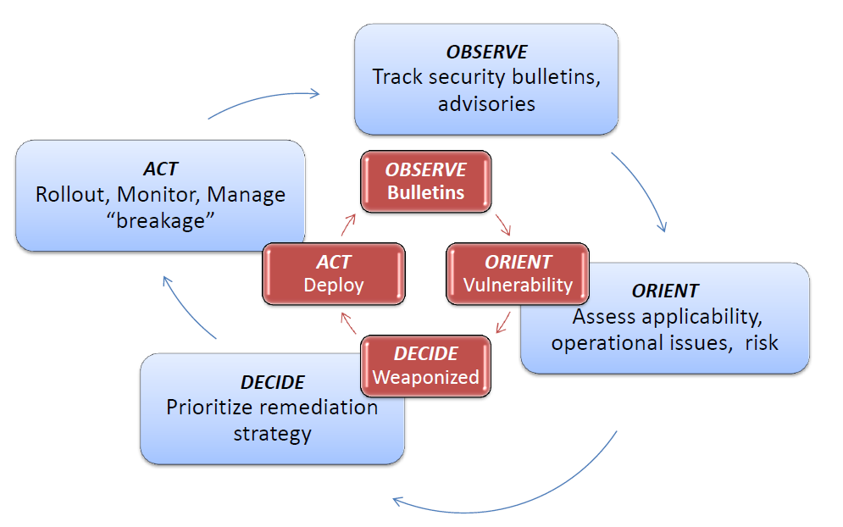
RECAP: Using OODA to Defend…….

Slide 42
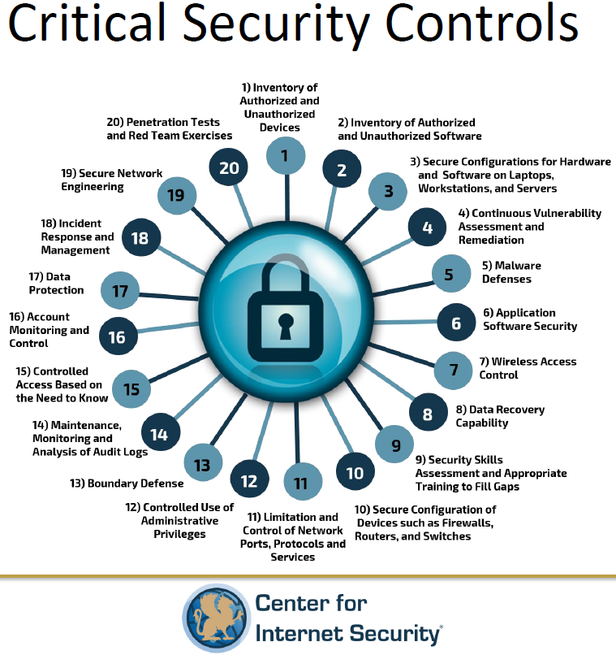

Slide 43
Takeaways
Many templates and guides can explain what elements need to be part of an IRPP.
Minimize initial involvement – Need to Know!
IR plans need to be built proactively and in a simple, flexible, and measurable way.
Communications: Insurance – Forensics and Law
Don’t overthink it.
Understand how you will measure your plan’s effectiveness.
Use : Observe – Orient – Decide – Act to facilitate improvements.

Slide 44
Summary
Identify the major components of dealing with an incident
Understand the incident handling lifecycle
Prepare a basic policy outlining a methodology for the handling of an incident
Report on Events to improve preparation for the future
What elements of disaster recovery and business continuity planning cross over from Incident Response

Slide 45
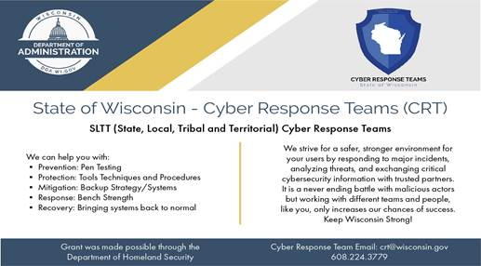
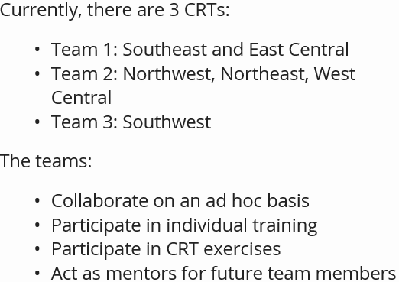
https://det.wi.gov/security/Pages/Cyber-Response-Teams.aspx

Slide 46
Resources
2017 Wisconsin Incident Response Playbook, every state listed: https://www.aba.com/Tools/Function/Cyber/Pages/IncidentResponseGuide.aspx#
Joint Chief of Staff Cyber Incident Handling Lifecycle: http://www.jcs.mil/Portals/36/Documents/Library/Manuals/m651001.pdf?ver=2016-02-05-175710-897
Using Incident Response to Drive Improvement: https://www.utdallas.edu/infosecurity/.../IncidentResponsePresentation-Austin-Final.ppt
NIST Security Incident Handling Guide - https://nvlpubs.nist.gov/nistpubs/specialpublications/nist.sp.800-61r2.pdf

Slide 47
Resources
FDIC, Supervisory Insights, Incident Response Program, https://www.fdic.gov/regulations/examinations/supervisory/insights/siwin06/article01_incident.html
U.S. Department of Commerce, National Institute of Standards and Technology, (NIST) – Special Publication 800-61, Revision 2, Computer Security Incident Handling Guide, http://nvlpubs.nist.gov/nistpubs/SpecialPublications/NIST.SP.800-61r2.pdf
CSRC: The Cyber OODA Loop: How Your Attacker Should Help You Design Your Defense - https://csrc.nist.gov/Presentations/2015/The-Cyber-OODA-Loop-How-Your-Attacker-Should-Help
SANS Critical Log Review Checklist - https://www.sans.org/brochure/course/log-management-in-depth/6
Credits to: Tony Sager - The Center for Internet Security (CIS)

Slide 48
Resources
Incident Response Update: What we're seeing so far in 2019 (and how to avoid it) (Gillware)
  The threat landscape for businesses shifts as cyber criminals find new methods and strategies for their attacks. Understanding the latest threats and how incident response works brings clarity when prioritizing your proactive security measures.
  https://zoom.us/webinar/register/6915517384950/WN_bG21kGtLQX2UXcofc6IYxA

