Slide 1
Surviving a Mock Disaster
Building an effective Tabletop Exercise
ISACA-KM March 20, 2019
Ken M. Shaurette, CISSP, CISA, CISM, CRISC
FIPCO Director IT Services
FIPCO ©

Slide 2
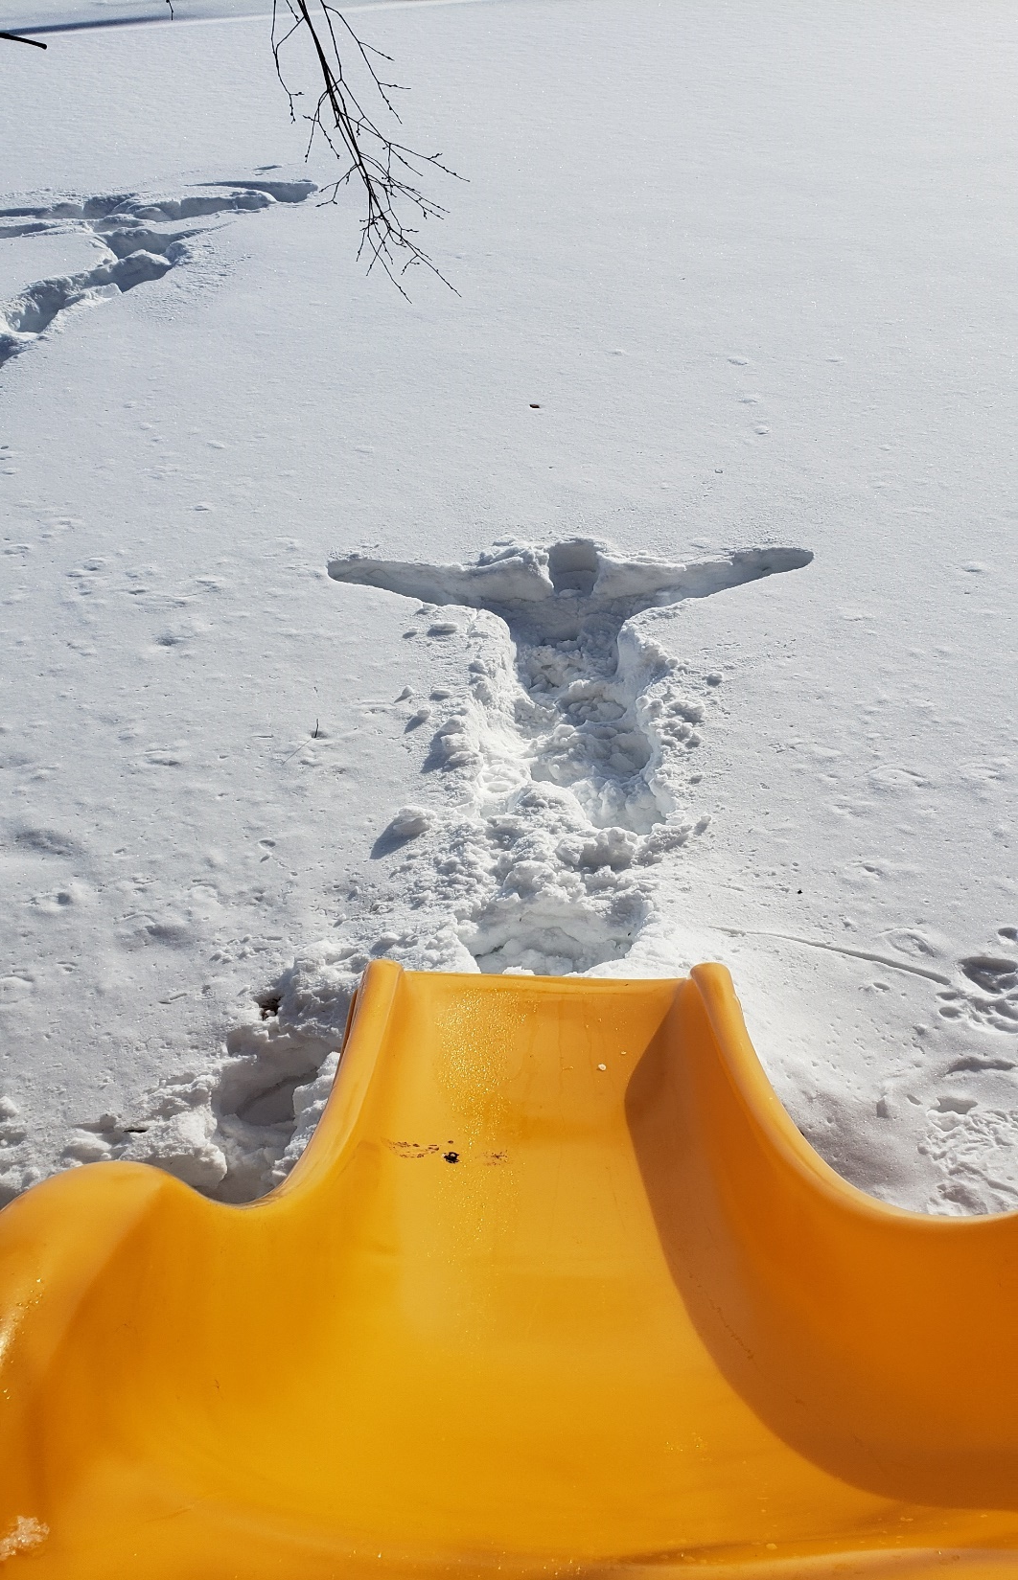
2019 Polar Plunge

Slide 3
Objectives
Identify the major components for BCP/DR.
Understand the types of Testing.
What is a Script versus a Scenario?
Why is a timeline script important?
Ties to Incident Response.

Slide 4
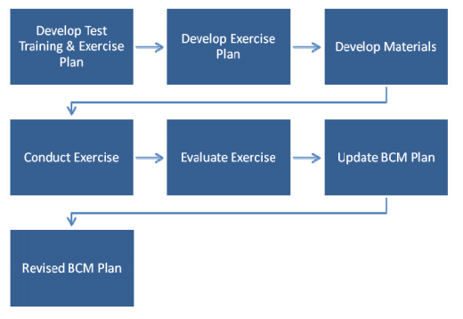
Continuity Plan Testing Flowchart

Slide 5
Ongoing Multi-Year Testing
Full Scale Exercises
Functional Exercises
Risk / Reward
Drills / Test
Tabletops
Orientation
Capabilities
Planning / Training / Maturity
Discussion Based
Operations Based

Slide 6
Types of Tests
Combination Test
ALL OUT TEST

Slide 7
Defining Roles and responsibilities
Position | Roles and Responsibilities
DR/BCP Coordinator / Information Security Officer | Coordinate schedule / Exercise facilitator
Management Team | Provide guidance and approval of Exercise Plan
IT – Manager / Network Admin | Coordinate IT Recovery Plans Plan and conduct IT Tests Support BCP Coordinator in Development and exercising
Participants (all employees, DR/BCP Team, Business Area Managers/SME) | Member of recovery team Familiar with Plan Know assignments Perform specific business duties

Slide 8
Functional and Full Scale Tests
IT Recovery - test restore of technology, (i.e. data, network)
Going offsite to a backup location tests recovery site preparedness, communications and utilities
Trained and informed personnel are typically performing recovery steps
Transaction testing verifies restore, connectivity and access using a person that knows the business process
Community resources may be involved
What verifies the completeness of the Plan?

Slide 9
Why Tabletop Exercises?
Provide a forum for the following:
Team Building
Validate the Plan Documentation
Information Collection and Sharing
Obtain consensus from team
Evaluation of Differing Perspectives
Practice makes Easier

Slide 10
Why Tabletop Exercises?
Provide a forum for the following:
Check that functional testing occurs
Problem solving of complex issues
Test considerations for new situations, ideas, processes and/or procedures
Training/Awareness for management and staff

Slide 11
Exercise Development Steps
Goals and Objectives –
What will success look like?
(SMART)
Simple (concise)
Measurable (how to document)
Achievable (can this be done)
Realistic (and challenging) (can it happen)
Task Oriented (fits to business functions)

Slide 12
Exercise Development Steps
Scope:
Exercise Activities
Departments Involved
Hazard - Type of Threat Source
Geographic or outage Impact Area
Staff Impacted
Facilities Impacted

Slide 13
Exercise Development Steps
Building a Script from a Scenario
Choosing a Threat to Test
Vulnerability – Threat Assessment
Start with simple basic scenarios – basic Fire minimal damage
Note: For example tornado incidents in the Midwest increased awareness of their threat risk.
The state may provide ongoing tasks of planning, preparing, and training for Tornado preparedness.
Threat Risk Asmt

Slide 14
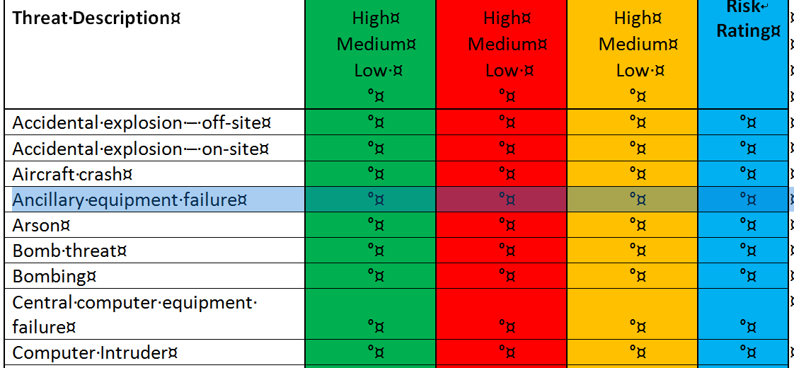
Threat Risk Assessment

Slide 15
Exercise Development Steps
Using a Scenario and Building a Script
As your DR/BC matures - make scripts more complex – increase maturity, add advanced “INJECTS”
Consider the unexpected – not could it happen, but what if it did.
Don’t share the scenario before the exercise
Does the DR/BCP Team always know when a tabletop will occur?

Slide 16
Exercise Development Steps
Building on a Scenario
How quickly can you pull together key Business Team Members?
How quickly can all key individuals be contacted and mobilized to the alternate location?
Do you test the involvement of any outside parties? (i.e. law enforcement, safety, utilities, telephone, ISP

Slide 17
Exercise Development Steps
Objectives of Exercise
Tabletop Exercise Program Objectives
To improve operational readiness by demonstrating knowledge of the DR/BCP Plan overall
To improve Company-wide coordination and response capabilities for effective disaster response
To identify communication pathways and problem areas between IT, outside entities (utilities, media) business areas, regional and state emergency operations centers
To establish timely response for safety, recovery and restore to normal operation.

Slide 18
Tips for an Effective Tabletop
Decide how much gloom and doom you want.
Do you want this to be a physical event with assets damaged and destroyed,
Do you just want things inaccessible?
Do you want death and injuries, or just to test the ability to get work up and going someplace else?
Do you test unavailable key people?
How long will your downtime duration be?

Slide 19
Conducting the Exercise
Set the Ground Rules
Silence Cell Phones
Establish timelines – Maximum 4 Hours - breaks, lunch etc..
Has Internal Audit been invited?
Who leads the exercise?
Can they facilitate and participate.
Consider issues that need to be tabled for later discussion

Slide 20
Conducting the Exercise
Set the Ground Rules (cont…)
Accept the Scenario as Real
Stay in the Scenario - stay in the mindset that the disaster is really occurring
Who will take notes – record issues / follow-up
Consider taping the exercise on an audio recorder

Slide 21
Exercise – Evaluate - Update
Planned Test scheduled in advance
Attendance by all BCP Team required
Team is aware of test scenario
Document Team Member Attendance
Confirm that all Team Members have their own up-to-date copy of the plan
The BC/DR coordinator confirms updates are in the plan.

Slide 22
Exercise – Evaluate - Update
Review policies and procedures
Discuss business area changes since last updates – detail continuity procedures
Confirm accuracy of phone numbers
Verify Secure and accessible storage of plan (at home)
Executive summary of the test and discussion results

Slide 23
TIP
Experience has shown that well planned and interesting exercises yield a high level of preparedness with personnel who are able to better cope with the stressful environment of an actual emergency.
Notes:
WePartner is the Wisconsin Emergency, a coalition of businesses, government, and community organizations working together to protect Wisconsin communities and improve disaster preparedness.

Slide 24
Resources
NIST SP800-84 - Guide to Test, Training, and Exercise Programs for IT Plans and Capabilities (google it)
Homeland Security Exercise and Evaluation Program (HSEEP) hseep.dhs.gov, FEMA: www.ready.gov/
National Incident Management System (NIMS: https://www.fema.gov/national-incident-management-system
Emergency Management for Your State emergencymanagement.wi.gov/
CSOonline Business Continuity, https://www.csoonline.com/resources/
FIPCO, www.fipco.com/itservices
Notes:
WePartner is the Wisconsin Emergency, a coalition of businesses, government, and community organizations working together to protect Wisconsin communities and improve disaster preparedness.

Slide 25
If Time Allows,
if not email kshaurette@fipco.com
Sample Tabletop Exercise Testing
FIRE
STORM
CLICK HERE
CLICK HERE

