Slide 1

WBA Secure-IT
Information/Cyber Security Awareness
September 2019
Stop, Think, Connect
Be Aware or Beware
Think Before You Click
Make Security Part of Your DNA

Slide 2
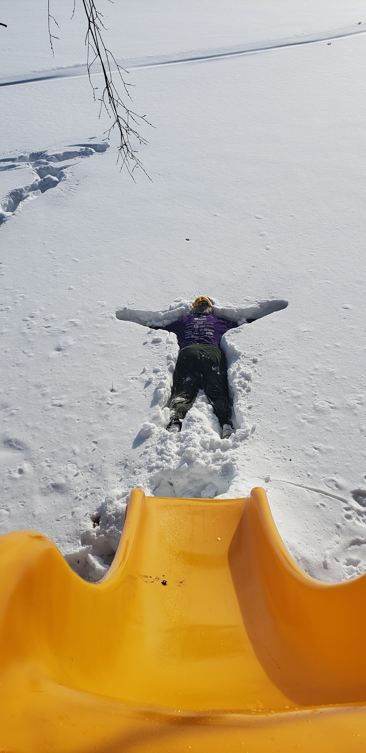
2019 Special Olympics Polar Plunge - Wisconsin
Ken M. Shaurette
CISSP, CISA, CISM, CRISC, NSA IAM
FIPCO
Director InfoSec and Audit
kshaurette@fipco.com
(608) 441-1251

Slide 3

Some Key Takeaways
When you leave today you will:
  Be armed with resources to:
    Educate the Board
    Educate Employees – Make Security More User Friendly
    Educate Customers
    Learn Something Yourself
  Better protect personal identity
  Protect staff, customer’s and partner’s private information
  Make better Cyber-Employee/Citizen?
  Rate your personal exposure

Slide 4
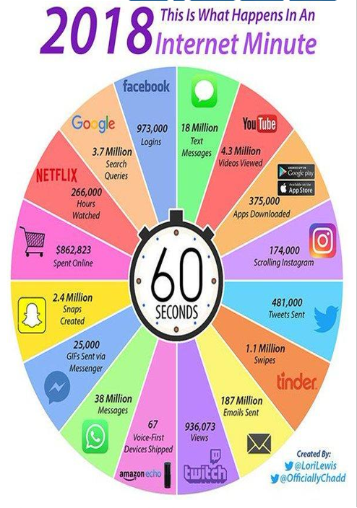
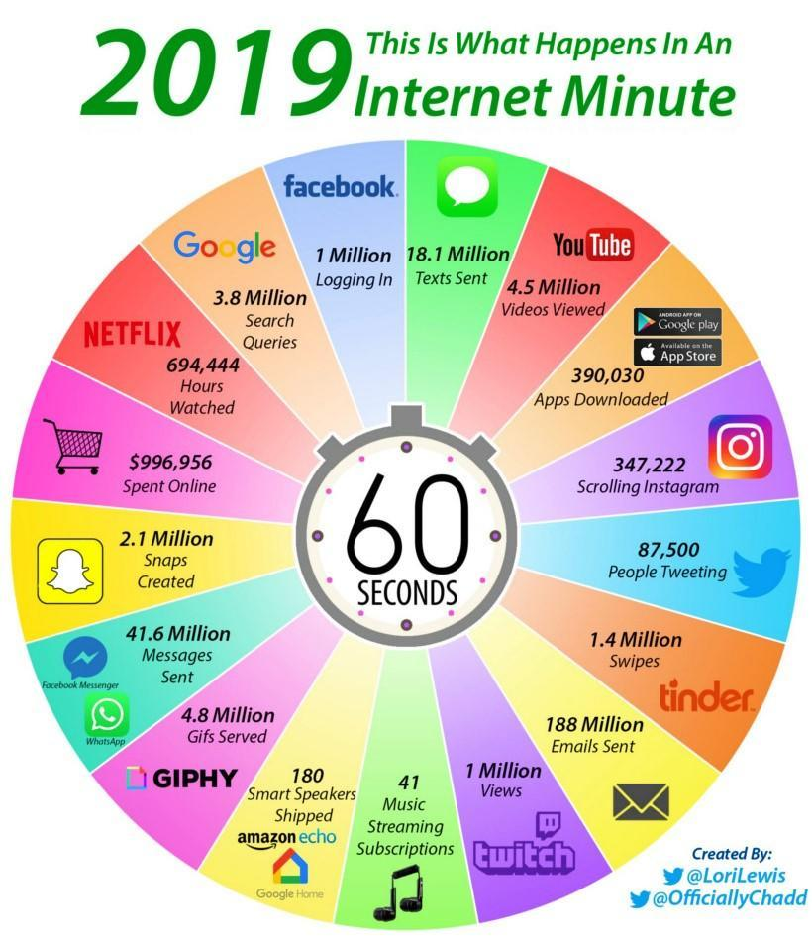

Slide 5
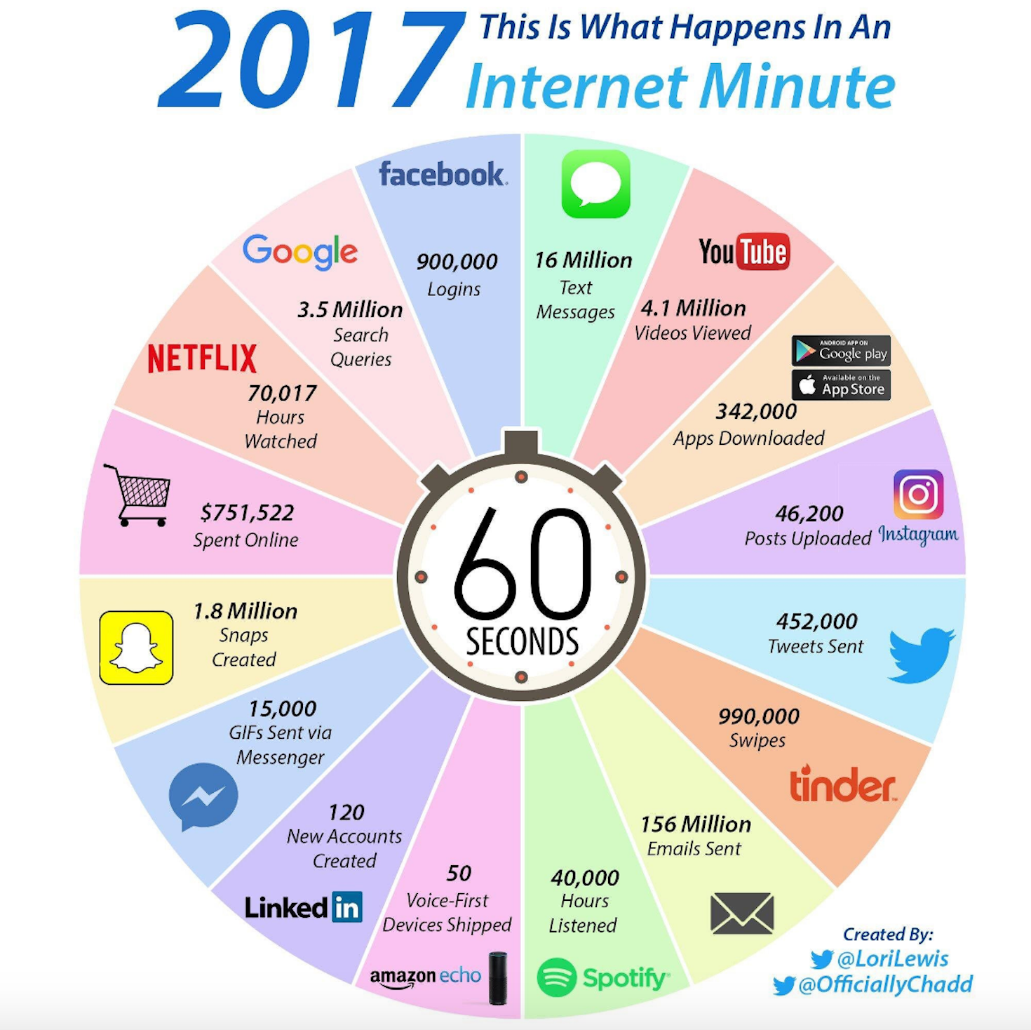

Slide 6
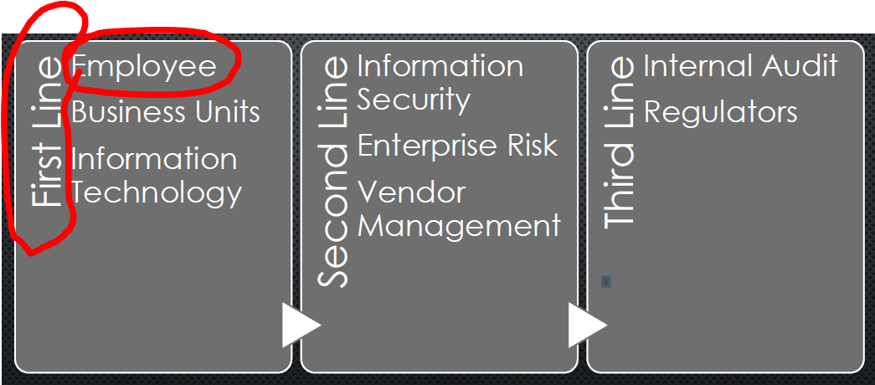
The Three Lines of Defense!
Thanks to Brent Maher – CISO Johnson Bank

Slide 7
Trojan Horses for The Mind
“When designed well, our messaging can sneak past mental defenses and noise. In other words, the way we design and deliver our messages can become a Trojan Horse.”
- Perry Carpenter, InfoSec Island, 12/07, 2018

Slide 8
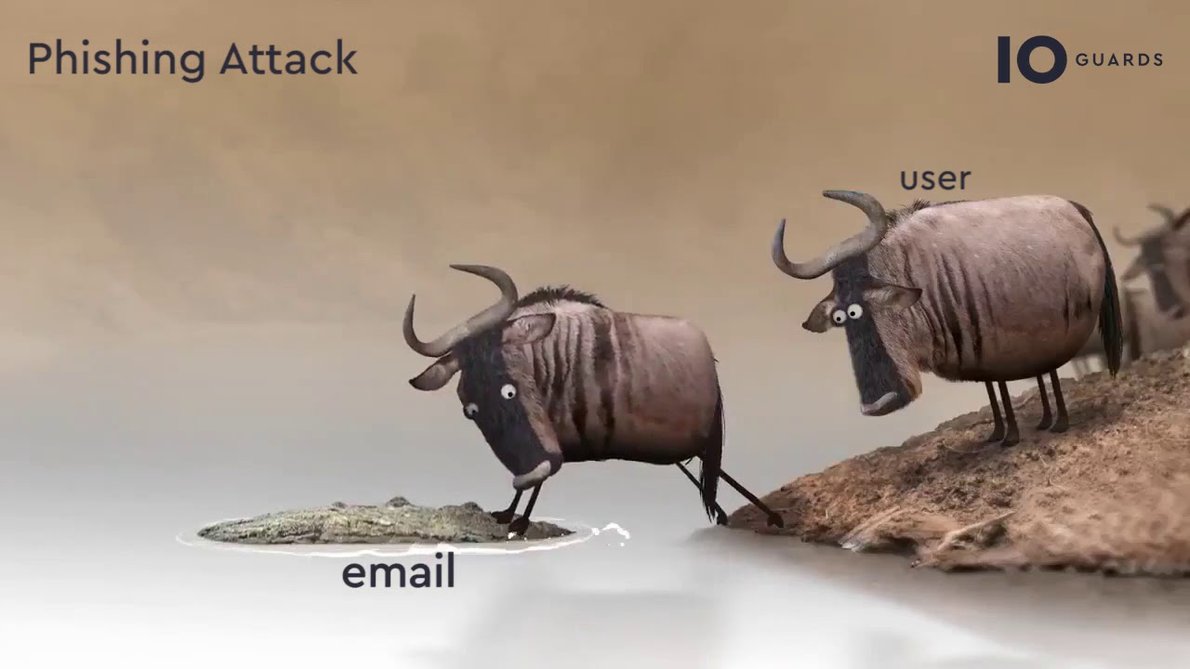
https://www.youtube.com/watch?v=yMnUEXhCenA

Slide 9
Do you Like Statistics / Metrics?
Thing to consider:
  What is the purpose or the Metric?
  Scare / FUD / Support for more staff?
  Defend a project

Slide 10
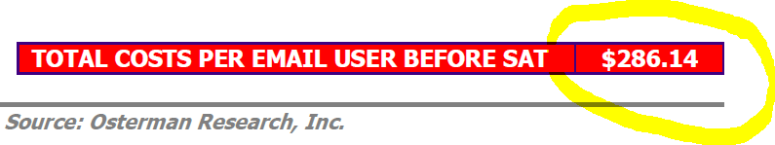
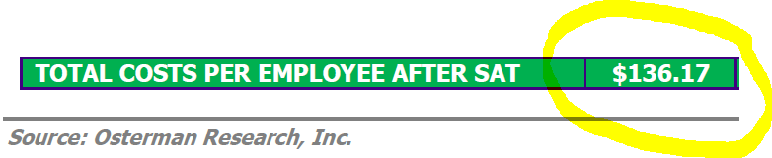
Security Awareness Training - SAT (ROI)
Costs Before and After Security Awareness Training for 50-99 Employees

Slide 11
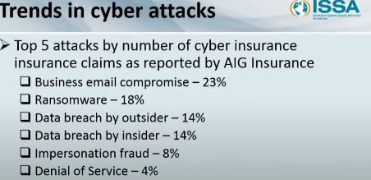

Slide 12
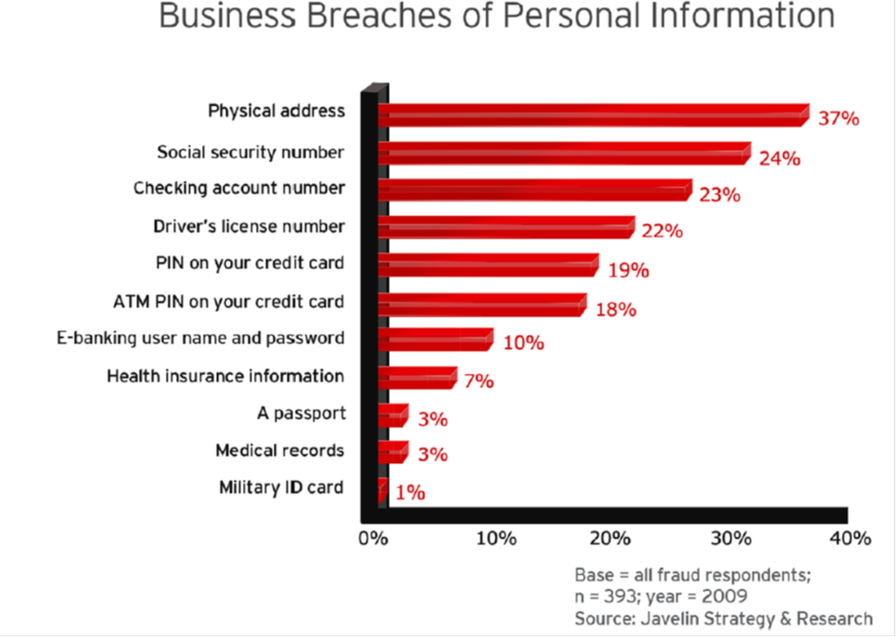
https://www.javelinstrategy.com/

Slide 13
What do you Consider in SAT?
Early in your Presentation
Provide definitions of key terms
Definitions may seem obvious, TO YOU but don’t assume people’s understanding of terms……

Slide 14
Definitions

Slide 15
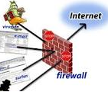
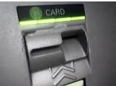
Definitions (cont.)
Firewall
An application or hardware device installed either on your pc or between your pc and the internet that allows you to monitor and block unwanted traffic.
Skimming
  Stealing information usually with a hardware device, Installed on an ATM or any card reader.

Slide 16
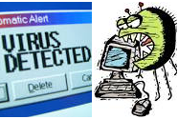
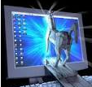
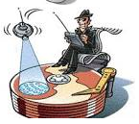
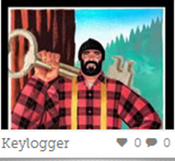
Definitions
Malicious Code - MALWARE
(Virus - Spyware – Trojan – BOT – Ransomware)
Short for malicious software, is any software used to disrupt computer or mobile operations, gather sensitive information, gain access to private computer systems, or display unwanted advertising.[

Slide 17
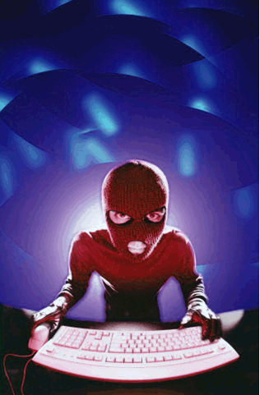
Threats
Malware : Short for malicious software is any software that does bad things to your computer.
Virus: A computer program that can replicate itself and spread from one computer to another.
Scareware: Scam software with malicious payloads or of no benefit, that are sold to consumers via certain unethical
marketing practices.
Spyware: A type of malware used to collect information without
your knowledge.
Approach
How
Thanks to Peter Garancis – Commerce State Bank Awareness Presentation to Business
Notes:
Malware :
Short for malicious software, is software designed to disrupt computer operation, gather sensitive information, or gain unauthorized access to computer systems.
Virus
A computer program that can replicate itself and spread from one computer to another. Commonly used to refer to other types of malware
Spyware
A type of malware used to collect information about users without their knowledge such as a keyloggers
Scareware
scam software with malicious payloads, or of limited or no benefit, that are sold to consumers via certain unethical marketing practices.

Slide 18
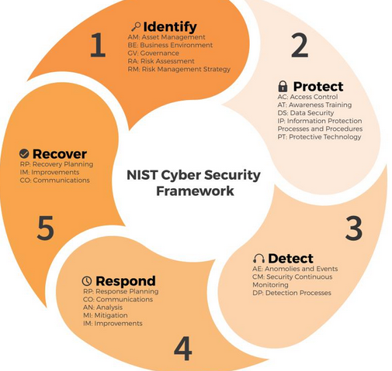
NIST Cybersecurity Framework
Information Security Awareness Crosses all Phases
https://www.us-cert.gov/ics/Assessments

Slide 19
Who Do You Train?
Employees
Customers
  Business
  Consumers
Management
Vendors
Board
Other

Slide 20
What Do You Train?
Employees
  IRP
  BCP/DR
  Policy
  Safe Computing Practices

Slide 21
What Do You Train?
Customers
  Business
    Email Compromise
    Account Takeover
    How to be aware for their customers
Customers
  Consumers
    Scams, Alerts
    Identity Theft Resources
    ATM, Debit, Credit Card Safety

Slide 22
What Do You Train?
Vendors
  Bank Policy
  Incident Response / Security Breach

Slide 23
What Do You Train?
Management
  Everything you train everyone else
Board : https://www.csbs.org/cyber101
  Cybersecurity (Information Security with a Twist)
  Information Security Program
    Ongoing Posture
    Scams, Incidents, Threat Intelligence
    Annual Update
    How can the Board help your InfoSec Program be successful?

Slide 24
Scams - Alerts
Example:
  DataSpii data leak Browser extensions impacting Chrome and Firefox
  8 browser Extensions stealing information!!!!
https://lifehacker.com/uninstall-these-eight-browser-extensions-that-stole-dat-1836539093
Notes:
information included was a lot of sensitive information such as payment card information, medical details, tax return data, GPS location, shopping history, and others. It also included corporate data such as real-time employee activity, private network structure, API keys, zero-day vulnerabilities, and lots of other stuff.

Slide 25
Scam Information
The extensions in question include for Chrome:
Hover Zoom – 800,000+ users
SpeakIt! – 1.4+ million users
SuperZoom – 329,000+ users
FairShare Unlock – Over 1 million users
PanelMeasurement – Over 500,000 users
Branded Surveys – 8 users
Panel Community Surveys – 1 user
Notes:
information included was a lot of sensitive information such as payment card information, medical details, tax return data, GPS location, shopping history, and others. It also included corporate data such as real-time employee activity, private network structure, API keys, zero-day vulnerabilities, and lots of other stuff.
If you downloaded any of these extensions, it’s best to delete them completely. You can do this in Chrome by typing chrome://extensions in your Chrome address line and then clicking the “Remove” button on the ones in question. For Firefox, type about:addons in the address bar and click “Remove.” While you're in there, remove any others you aren't using.

Slide 26

Extensions of Concern:
For Firefox:
SuperZoom – 329,000+ users
SaveFrom.net Helper – Around 140,000 users
FairShare Unlock – Over 1 million users
Notes:
information included was a lot of sensitive information such as payment card information, medical details, tax return data, GPS location, shopping history, and others. It also included corporate data such as real-time employee activity, private network structure, API keys, zero-day vulnerabilities, and lots of other stuff.
If you downloaded any of these extensions, it’s best to delete them completely. You can do this in Chrome by typing chrome://extensions in your Chrome address line and then clicking the “Remove” button on the ones in question. For Firefox, type about:addons in the address bar and click “Remove.” While you're in there, remove any others you aren't using.

Slide 27
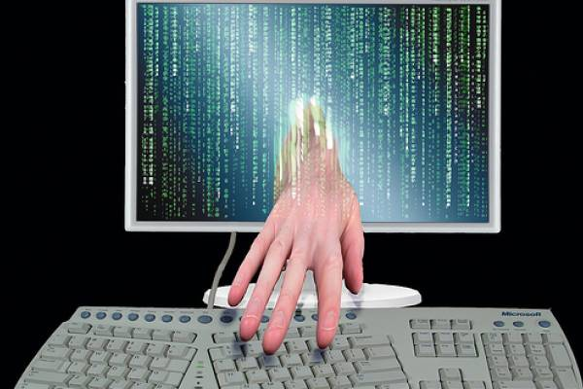
Where the Attack Threat Starts
Deception and Technology Tricks
  Social Engineering = Persuasion
  Infected websites…..
  Look for weak practices to get into places
  Hackers expect people not to be familiar with weak areas of our technology and practices

Slide 28
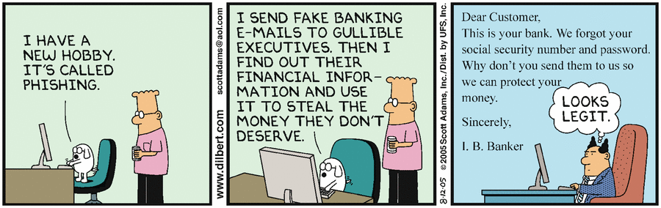
Phishing….. (3 min - crooks)
https://www.youtube.com/watch?v=sed6rtDBuHk

Slide 29
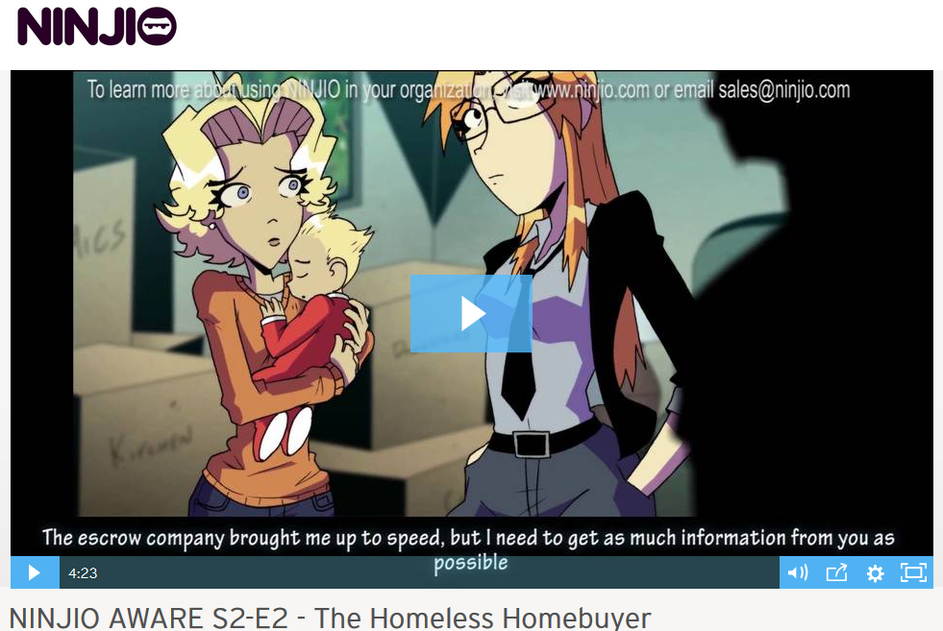
Could this happen?

Slide 30
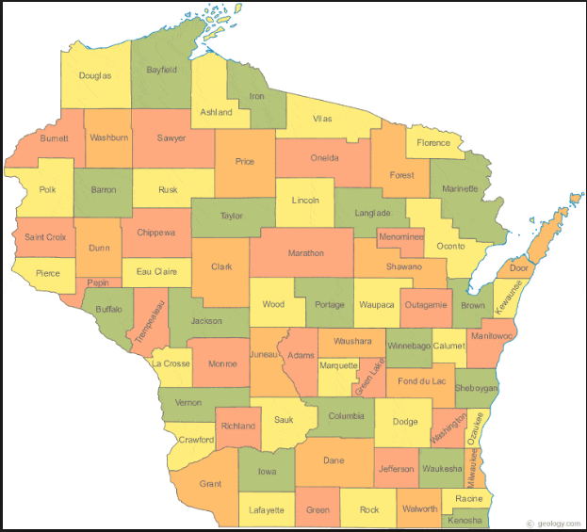
Are Scams Really Happening?
https://www.bbb.org/scamtracker/us

Slide 31
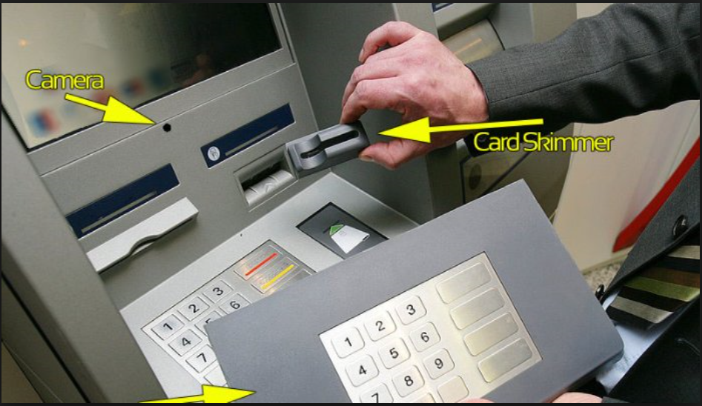
ATM Skimming….
https://www.youtube.com/watch?v=gJo9PfsplsY

Slide 32
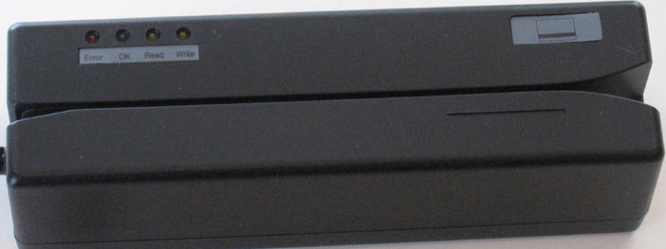
http://www.identitytheft.info/personalsecurity.aspx

Slide 33
Awareness…
Know your rights!
Banks and legitimate organizations do not typically collect confidential information using email.
You can always go direct to the organization like your bank to make sure it is legitimate.
Be Cautious, Be Paranoid, Be Careful!!
Beware & Be very Aware
Notes:
What to Do if You Receive a Harassing Call From a Debt Collector:
The best protection against debt collection scams is simply knowing your rights. Here's a quick overview.
Ask the debt collector to provide official "validation notice" of the debt. Debt collectors are required by law to provide the information in writing. The notice must include the amount of the debt, the name of the creditor and a statement of your rights under the Fair Debt Collection Practices Act. If the self-proclaimed collector won't provide the information, hang up.
If you think that a caller may be a fake, ask for his name, company, street address, and telephone number. Then, confirm that the collection agency is real.
Do not provide or confirm any bank account, credit card or other personal information over the phone until you have verified the call.
Check your credit report for by going to annualcreditreport.com or calling (877) 322-8228. This will help you determine if you have outstanding debts or if there has been suspicious activity under your name.
If the scammer has a great deal of personal information about you, be safe and place a fraud alert on your credit report.
File a complaint with the Federal Trade Commission if the caller uses threats. The Fair Debt Collection Practices Act prohibits debt collections from being abusive, unfair or deceptive.

Slide 34
Why Do We Need Information Security Awareness
To protect staff, customers, and business partners
To protect employees from harm
To communicate the best practices for protection
To communicate our position on security and proper information protection
Information protection practices are not static – They always change to accomplish overall security goals (Consistent Communication is the Key to Success)
Communicate IRP and BCP/DRP Procedures

Slide 35
Does Shock & Awe Work? (FUD)
Consider how fear would impact delivery of a message.
Fear, Uncertainty and Doubt (FUD)
Reward versus the Big Stick
Notes:
http://fox6now.com/2013/01/31/contact-6-preventing-cyber-spying/

Slide 36

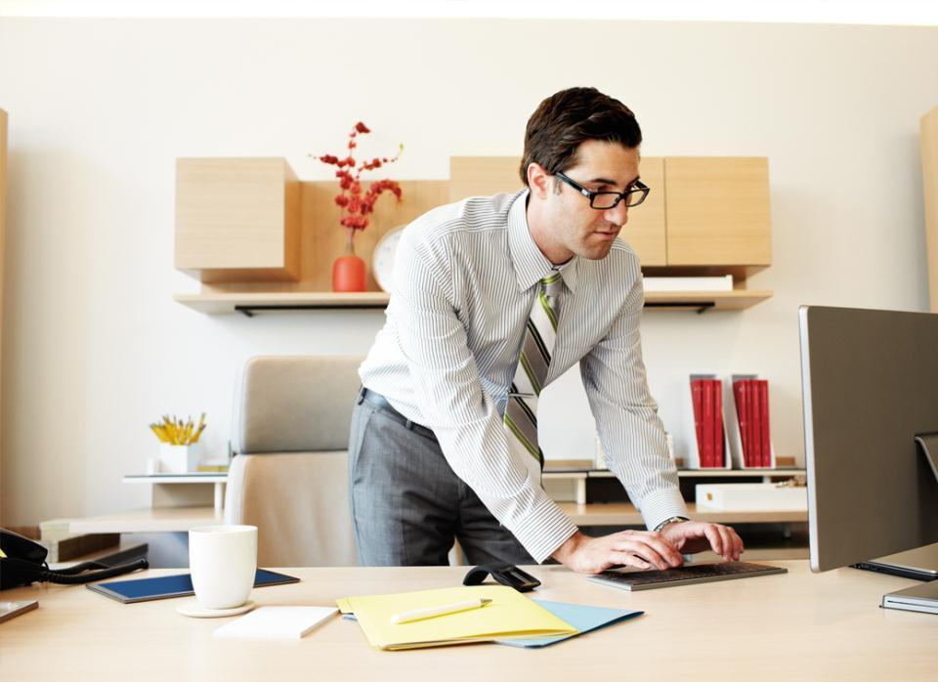
Make Security More User Friendly
https://www.grc.com/haystack.htm
Notes:
SLIDE 13
TALKING POINTS
You lock your house, your car, your bike. You also need to lock corporate assets, client info, devices (like phones, laptops, and company routers), online accounts and so on with passwords and PINs—and change them regularly.
So what makes a password strong? [click]

Slide 37
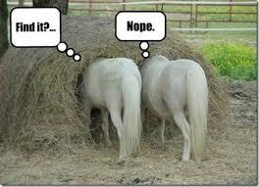
... and how well hidden is YOUR needle?
If every possible password is tried, sooner or later yours will be found.
The question is: Will that be too soon . . . or enough later?

Slide 38
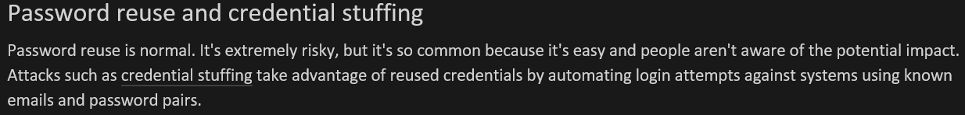
Testing Exposure of Passwords
https://portal.spycloud.com
https://monitor.firefox.com/
https://haveibeenpwned.com/
Verizon's Data Breach Report showed that 81% of hackin g-related breaches used stolen or weak passwords.
https://enterprise.verizon.com/resources/reports/dbir/

Slide 39
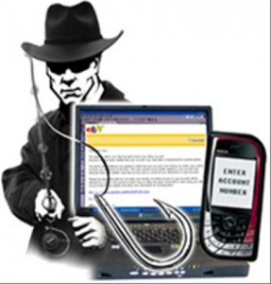
Passwords Still The Keys
To the Kingdom
Minimize Reuse of Passwords
  Don’t use your Corporate Passwords at home or vice versa, separate passwords….
    Banking (One for the Money)
    Entertainment (Two for the Friends)
    Email (Three for the Email)
    For the Corporation (at work)
Use Password Vaults (aka Password Managers)
  Lastpass, Keepass, Dashlane, etc..
https://www.digitaltrends.com/computing/best-password-managers/
https://www.pcmag.com/roundup/300318/the-best-password-managers
https://www.wired.com/story/best-password-managers/

Slide 40
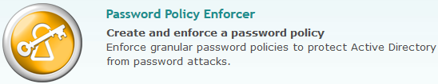
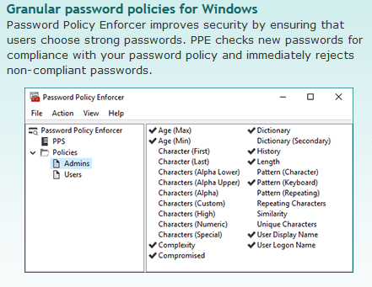

Slide 41
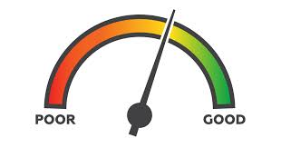
Create strong passwords
Which passwords are weak?
Don’t Trust Password Strength Meters
WHY?
Step 4
Notes:
SLIDE 14
NOTE TO SPEAKER
This is a chance for the audience to test
their ability to gauge password strength. Give
everyone 5 or 10 seconds to think about and
decide whether the password is strong. Or ask
for volunteers to give an explanation and then
show the answer.
Here’s how it works:
When the title of the slide comes up, click
your mouse to display the first password.
After 5 or 10 seconds, click your mouse again
to display the answer and read the explanation in the talking points.
Then click your mouse to display the next password.
Repeat Steps 2 and 3 to make your way through the entire list.
TALKING POINTS
I’m going to show a password and give you a few seconds to determine whether it’s strong—and why or why not. [click]
WEAK. This is the most common business password, so it’s at the top of criminal lists to test. [click]
WEAK. A date—birthday or anniversary, for example—can be known and easily found by a criminal. [click]
WEAK. Don’t use a single word that you can find in any dictionary in any language (advantageous). Criminals can easily break common replacements such as an exclamation point for “t” or zero for “o.” [click]
STRONG. SwanRiceRedDoor
Uses words that don’t make sense grammatically, but mean something to the person who made up the password. It’s also long and uses upper and lower case letters, numbers, and symbols. [click]
WEAK. Avoid using only numbers--number sequences, repeated numbers, like 22222222, or numbers like Social Security numbers. [click]
STRONG. This password took the first letters from this sentence:
My son Aiden was 3 years old in December.
This is a sentence that was easy for the person who made it up to remember, but difficult for others to guess. Mixing in capital and lowercase letters, symbols, and numbers adds complexity.
Now that you have a better sense of what makes passwords strong, let’s look at how to use strong passwords so they’re most effective. [click]

Slide 42
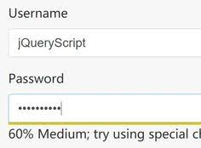
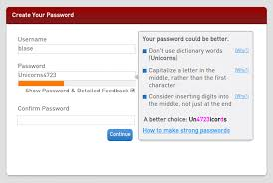
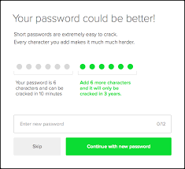
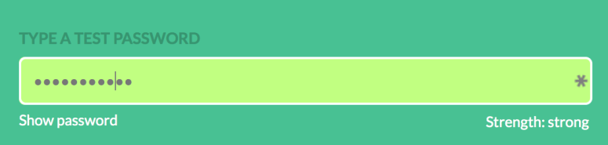

Slide 43
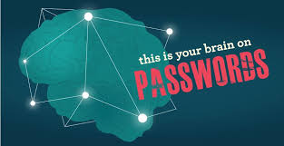
Create strong passwords
Which passwords are weak?
8 Characters?
Even with Special Characters
WEAK
Notes:
SLIDE 14
NOTE TO SPEAKER
This is a chance for the audience to test
their ability to gauge password strength. Give
everyone 5 or 10 seconds to think about and
decide whether the password is strong. Or ask
for volunteers to give an explanation and then
show the answer.
Here’s how it works:
When the title of the slide comes up, click
your mouse to display the first password.
After 5 or 10 seconds, click your mouse again
to display the answer and read the explanation in the talking points.
Then click your mouse to display the next password.
Repeat Steps 2 and 3 to make your way through the entire list.
TALKING POINTS
I’m going to show a password and give you a few seconds to determine whether it’s strong—and why or why not. [click]
WEAK. This is the most common business password, so it’s at the top of criminal lists to test. [click]
WEAK. A date—birthday or anniversary, for example—can be known and easily found by a criminal. [click]
WEAK. Don’t use a single word that you can find in any dictionary in any language (advantageous). Criminals can easily break common replacements such as an exclamation point for “t” or zero for “o.” [click]
STRONG. SwanRiceRedDoor
Uses words that don’t make sense grammatically, but mean something to the person who made up the password. It’s also long and uses upper and lower case letters, numbers, and symbols. [click]
WEAK. Avoid using only numbers--number sequences, repeated numbers, like 22222222, or numbers like Social Security numbers. [click]
STRONG. This password took the first letters from this sentence:
My son Aiden was 3 years old in December.
This is a sentence that was easy for the person who made it up to remember, but difficult for others to guess. Mixing in capital and lowercase letters, symbols, and numbers adds complexity.
Now that you have a better sense of what makes passwords strong, let’s look at how to use strong passwords so they’re most effective. [click]

Slide 44

Create strong passwords
Which passwords are weak?
!lov3you
Or
BlueChristmasCar
Neither One or potentially BOTH
Step 4

Slide 45
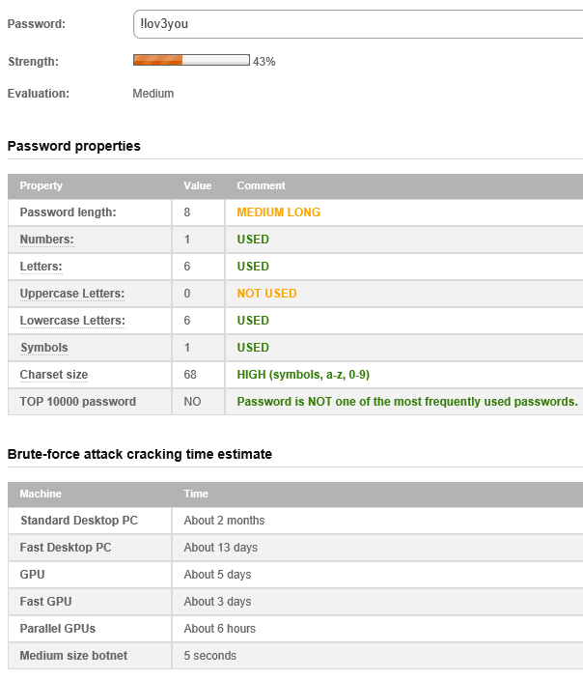
http://password-checker.online-domain-tools.com/

Slide 46
Oh no - !lov3you — pwned!
This password has been seen 39 times before.
This password has previously appeared in a data breach and should never be used. If you've ever used it anywhere before, change it!
https://haveibeenpwned.com/Passwords

Slide 47
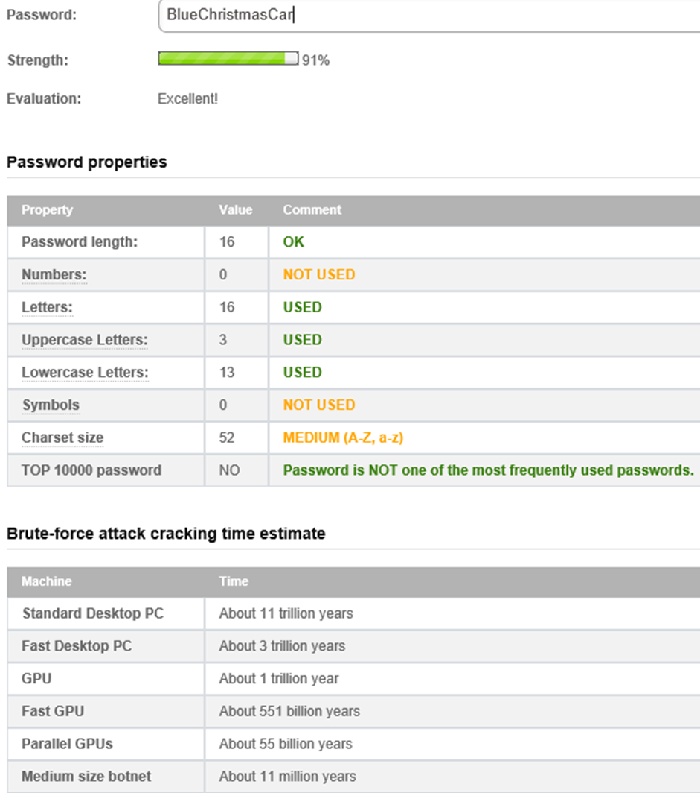

Slide 48
Create strong passwords
Which passwords are strong?
THINK LONG Uncompromised as STRONG
15 characters +
STRONG
Notes:
SLIDE 14
NOTE TO SPEAKER
This is a chance for the audience to test
their ability to gauge password strength. Give
everyone 5 or 10 seconds to think about and
decide whether the password is strong. Or ask
for volunteers to give an explanation and then
show the answer.
Here’s how it works:
When the title of the slide comes up, click
your mouse to display the first password.
After 5 or 10 seconds, click your mouse again
to display the answer and read the explanation in the talking points.
Then click your mouse to display the next password.
Repeat Steps 2 and 3 to make your way through the entire list.
TALKING POINTS
I’m going to show a password and give you a few seconds to determine whether it’s strong—and why or why not. [click]
WEAK. This is the most common business password, so it’s at the top of criminal lists to test. [click]
WEAK. A date—birthday or anniversary, for example—can be known and easily found by a criminal. [click]
WEAK. Don’t use a single word that you can find in any dictionary in any language (advantageous). Criminals can easily break common replacements such as an exclamation point for “t” or zero for “o.” [click]
STRONG. SwanRiceRedDoor
Uses words that don’t make sense grammatically, but mean something to the person who made up the password. It’s also long and uses upper and lower case letters, numbers, and symbols. [click]
WEAK. Avoid using only numbers--number sequences, repeated numbers, like 22222222, or numbers like Social Security numbers. [click]
STRONG. This password took the first letters from this sentence:
My son Aiden was 3 years old in December.
This is a sentence that was easy for the person who made it up to remember, but difficult for others to guess. Mixing in capital and lowercase letters, symbols, and numbers adds complexity.
Now that you have a better sense of what makes passwords strong, let’s look at how to use strong passwords so they’re most effective. [click]

Slide 49
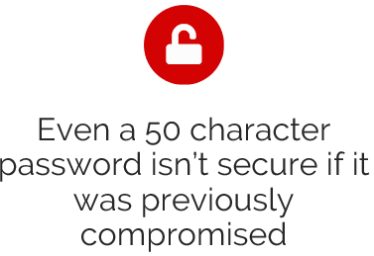
https://nakedsecurity.sophos.com/2015/03/02/why-you-cant-trust-password-strength-meters/

Slide 50
Have you Ever?
Received Spam email that contains your password
  It's asking me to send money.
  What should I do?
  555,278,657 real world passwords exposed in data breaches.
  This exposure makes them unsuitable for ongoing use
https://haveibeenpwned.com/Passwords

Slide 51




Some Examples…..
Make passwords strong – Long is Strong
Keep them private
Use unique passwords
As a Company:
Password Policy Enforcers
Personally and as a Company
Password Managers
Step 4
Notes:
SLIDE 15
TALKING POINTS
In addition to password strength, how else can you use passwords to help protect data? [click]
Don’t disclose passwords or PINs to anyone. Many account takeovers occur because the owner shared the password.
Don’t store them on your phone, or in a file or on a post-it on your computer. It’s okay to store them on a sheet of paper hidden away from your desk.
Don’t let anyone trick you into revealing them. [click]
Don’t use the same password (or even simple variations) for different accounts. Use a unique password or PIN for each account or device (including your computer and mobile phone) containing personal or business data. Otherwise, if one is stolen or inadequately protected by the site, all the accounts it protects are at risk. [click]
And last, you’ll want to take a few extra precautions when you travel for work. [click]

Slide 52
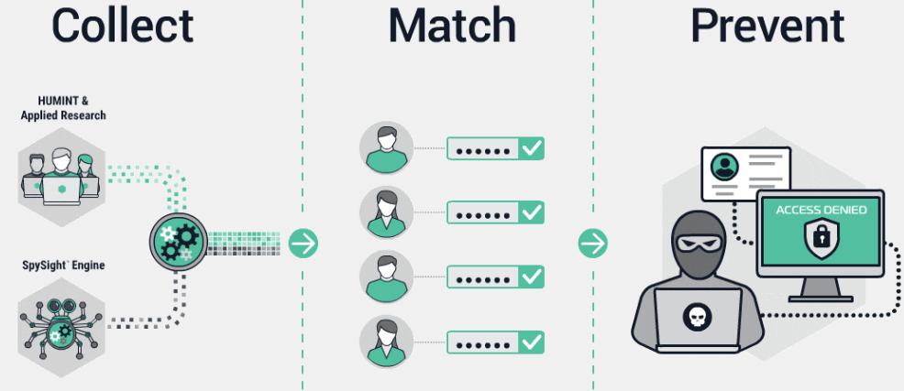

Slide 53
Shifting Gears Again

Slide 54
Preventing CyberSpying…..
Look around you right now. Do you have a camera or your laptop nearby? How about your cell phone? If so, who’s watching you?
CLICK HERE
Fox Contact 6: Cyber Spying
Notes:
http://fox6now.com/2013/01/31/contact-6-preventing-cyber-spying/

Slide 55
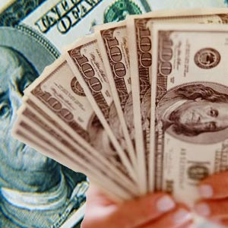
Cyber Criminal
Motives
Money
Politics
Personal Recognition
Identity Theft
Knowing They Can

Slide 56

It’s Worth More
  An identity is stolen every 4 seconds in the US.
  The average cost to restore a stolen identity is $8,000.
  Victims spend an average of 600 hours recovering from this crime.
  Lose once likely to lose again

Slide 57
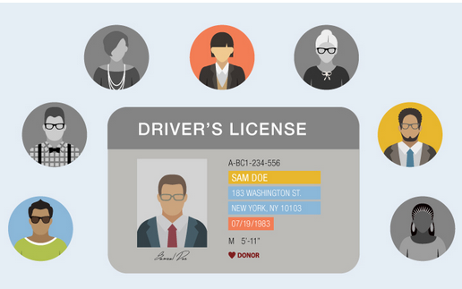
Criminal Identity Theft
Synthetic IDs: Great For Fraudsters, Bad For Victims
Identity theft… without your full identity
It’s called synthetic identity theft. Whether by a phishing scam, data breach, hack or physical theft, your information becomes compromised and falls into the wrong hands. Criminals use this stolen information to mix and match names, birthdays, Social Security numbers and addresses with other fabricated information to create synthetic IDs.
Once the synthetic identity is made, criminals can make fraudulent charges to your bank account, open new lines of credit, order prescriptions and even commit crimes under your name.
https://www.fightingidentitycrimes.com/synthetic-ids-great-for-fraudsters-bad-for-victims/

Slide 58
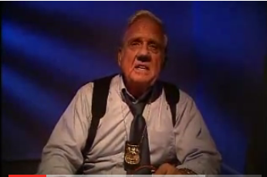
Criminal Identity Theft
http://www.identitytheft.info/criminal.aspx

Slide 59
Cyber Criminal Methods
Review Web Sites
Search Internet for information
Call and email the Bank attempting to trick us
Read our trash, desktops, and workspace area
Look for weaknesses in Bank technology,
And People!!
Look for weakness in Bank change and configuration management practices

Slide 60
Personalize the Message
If an employee handles data like it is their data or that of their family they will treat it well.
If an employee uses Facebook, Instagram or Pinterest etc.. Safely; they will likely be a safe Online Banker or employee.

Slide 61
Ways That Employees
Can Contribute
Do not:
  Use Bank e-mail ID’s for non-business use
    Reuse your passwords on multiple websites to log in regardless if you use a different user account
  Share accounts and passwords
  with ANYONE

Slide 62
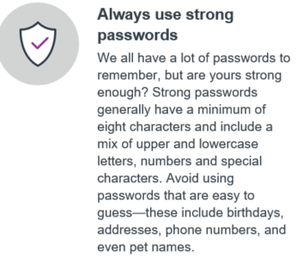
Identity Theft Protection Tips

Slide 63
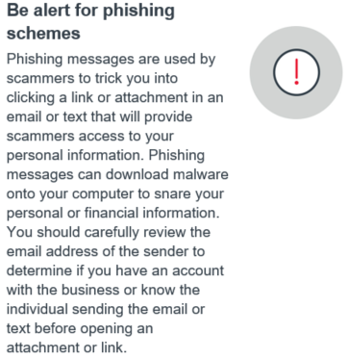
Identity Theft Protection Tips
https://www.equifax.com/personal/education/identity-theft/?Et_cid=554678&Et_rid=46007779

Slide 64
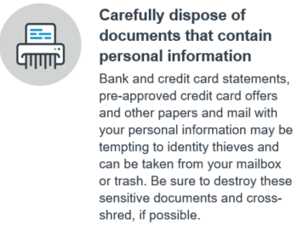
Identity Theft Protection Tips

Slide 65
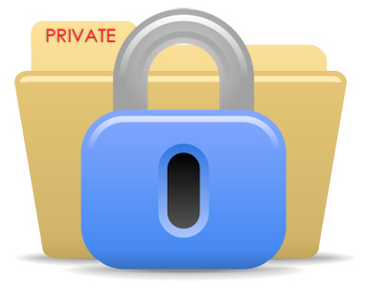
Employee
Actions That Make a Difference
Appropriate Use Policy– What you should and shouldn’t do with technology systems (Computers, Laptops, notebooks, Cell Phones, Printers)
Security Responsibility – How you can contribute to Bank success in protecting information and systems

Slide 66
Employee
Actions That Make a Difference
Password Usage – Ways to protect your password and identity
Internet Usage – Ways you can protect yourself while on the Internet
Email Usage – Ways that you can protect information while using email
Careful where you Surf – Websites that is!

Slide 67
Encourage Participation

Slide 68
Ways That You Can Contribute
Do not:
  Open unexpected e-mail attachments, even if they are from someone you know – danger of imposters – phishers
  Open attachments of types that are not of common types
  Respond to spam, do not “unsubscribe”

Slide 69
Ways That You Can Contribute
Do not:
  Send non-public data through email or other technology unless it is encrypted
  Visit Internet sites that could cause systems harm
  Install non-credible software from any website
    Keep this in mind with Mobile Apps

Slide 70

Ways That You Can Contribute
Guard against being deceived or accidentally disclosing information
Do Not:
  Give Out Personal Information Over the Phone
  Ask for personal computer information from another co-worker
  (There are special circumstances. Verify Requestor)
  Let unrecognized guests go without escort

Slide 71
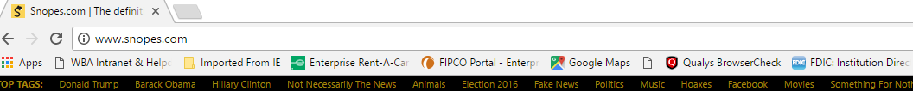
Ways That You Can Contribute
Protect Paper Copies
Do Not:
  Throw away non-public information without shredding
  Leave unattended for a long period of time
  Provide to Third-Party unless approval has been obtained

Slide 72
Answers – Caution & Paranoia
Hopefully you weren’t looking for an answer to protect you from you.
The industry doesn’t have a technology answer yet, but you can be either part of the solution or part of the challenge.
Be Aware & Beware
Notes:
Stop and think before you click links, open photos, songs, or other attachments in a message from someone you don't know. Be wary of "free" games, apps, and the like, which are notorious for including malware in the download.
Even be suspicious of links and attachments from someone within your company, especially if it’s something unexpected, like ilovepinkponies.pdf from your boss. Or, just because the email message says it’s a LinkedIn update, doesn’t mean it is. You never know if a criminal has hacked into a coworker’s account, or that his or her computer has been infected with a virus that is automatically sending spam. [click]
Confirm. If you think it’s suspicious, don’t click anything or use phone numbers or email addresses in the message. Instead, use a different device and another account to confirm with the sender that the message is legitimate.
Or do some research. For example, the executives in our example might have paused to consider whether their companies were involved in litigation that could result in a subpoena from this court. [click]
Close. Avoid clicking Agree, OK, or I accept in banner ads, in unexpected pop-up messages or warnings, on websites that seem suspicious to you, or in offers to remove spyware or viruses. These also could trigger the download of malware. [click]
Instead close the window. To do this, press Ctrl and F4 on your keyboard.
And the advice, “If you see something, say something,” applies here. If you do see a message that seems suspicious or problematic, report it to the system administrator who can take action including warning others what to do if they see the same thing.

Slide 73
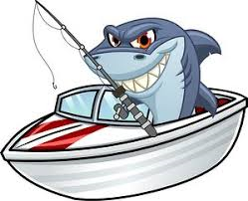
Teach Phishing
Do’s and Don’ts
https://www.phishing.org/what-is-phishing

Slide 74
Phishing Attacks Dos and Donts
Five DO's:
Review the email for grammar and spelling
While many attackers have improved over the years, some attacks still have pretty noticeable misspellings and other grammatical errors. Abnormal spacing and formatting may also be a sign of a phishing email.
Inspect the links
Attackers will embed malicious URLs into seemingly legit ones within their emails. Use the mouse to hover over the hyperlink to determine if there is an embedded URL.
Validate the request
If you receive an email from a fellow employee or vendor requesting information, pick up the phone and verify the request. Always use contact numbers from external websites – NOT the ones included in the potential phishing email.

Slide 75
Phishing Attacks Dos and Donts
Five DO's:
Alert the appropriate personnel
If you think you have received a phishing email, getting it to the proper person in the IT department is critical. They may be able to block others from receiving it or block access to any links that were included in the phishing email. Don’t hesitate to forward suspicious emails to the appropriate IT staff!
Use common sense
If a vendor of three years has never asked for your password information through email, they probably wouldn’t be starting today. If a coworker of two years has never sent you an attachment and sends you one today and tells you to enable macros, don’t. Question requests that are outside the norm and use common sense when fulfilling requests.

Slide 76
Phishing Attacks Dos and Donts
Five Don’ts:
Don’t trust the sender
  It doesn’t take any time or skill to “spoof” or impersonate the sender of an email. From the president of your organization to the President of the United States, attackers can assume the identity of anyone.
Don’t be so quick to reply
  Sometimes attackers are just looking to find valid email addresses within an organization or to identify the naming convention used within an organization. By replying to an email like this, even if it’s only to give the would-be attacker a piece of your mind, you only help the attacker determine that the email reached a recipient.
Don’t open that attachment
  Attachments that were once thought of as harmless (Word, Excel, PDF) are now being used to launch various types of attacks against end-users. If you weren’t expecting that attachment – don’t open it!

Slide 77
Phishing Attacks Dos and Donts
Five Don’ts:
Don’t give out personal information
  Most companies will not ask you to transmit personal information, account information, or account passwords via email. Any requests similar in nature should raise suspicions and be reported.
Don’t be embarrassed
  These attacks work, which is why we’ve seen an increase in the amount of phishing attacks. Don’t be embarrassed that you fell for it. Don’t try to fix it yourself. Don’t assume you’ll be in trouble. Alert the appropriate IT personnel immediately and wait for further instructions. The faster they become aware of the issue the greater chance they can reduce the number of users that will be affected.

Slide 78
Rate Your Personal Exposure?
Environment
Which of the following statements best describes your personal cyber environment?
I have multiple devices, usually of the latest offerings, that I keep connected whether in social, work, or home environments. (9)
I have multiple devices but keep their use appropriate to the situation. (7)
I have a few devices that I use only in the appropriate settings and with the proper security. (4)
I have a older PC and a simple cell phone (1)

Slide 79
Rate Your Personal Exposure?
Connectivity
Which of the following statements best describes how you connect and use technologies in your personal and work environments.
I like to stay connected whether at home, work or travelling. I am always connected and like to find free hot spots. (9)
I try to stay connected and use trusted networks at home and work but will use what is at hand when I travel. (7)
I like to be connected and use the secure networks at home and work but when travelling try and find secure networks to connect to. (4)
I only connect and use technology when I am sure I am on a safe and secure network. (1)

Slide 80
Rate Your Personal Exposure?
Firewalls and Security
Which of the following statements best describes how you deal with firewalls and security.
I use firewalls and other security with settings that allow me the greatest freedom. I assume networks that I use have good firewalls and security. (10)
I use firewalls and other security with settings that provide good protection. I assume networks that I use have good firewalls and security. (8)
I prefer to work in environments that have good, known protection. This means firewalls with the highest setting and other security to stop intrusions and other malware. (4)
I will only work in environments that have the highest protection. This means firewalls with the highest setting and other security to stop intrusions and other malware. (1)

Slide 81
Rate Your Personal Exposure?
Social Media
Which of the following statements best describes your participation in various social media?
I am an avid participant in social media and am in several. I generally allow my information to be shared and open to the public. (10)
I participate in social media and am in several. I generally restrict my information to friends and contacts. (7)
I participate in social media and restrict my information to a few friends and contacts. (4)
I do not use social media for any purpose (1)

Slide 82
Rate Your Personal Exposure?
Back Up and Security
Choose the statement that best describes your approach to backing and protecting your info.
I know I should back up my personal information and encrypt some of it, however, I never seem to find the time or have other issues that get in the way. I rely on the staff at work to do the appropriate back up and encrypting. (9)
I back up my personal information and encrypt some of it, however, I do not do it as often as I would like, nor do I do it on a regular basis. I discuss with the staff at work the appropriate back up and encrypting. (7)
I back up and encrypt my sensitive and important personal information, however, I do not do it as regularly as I would like. I work with staff at work the appropriate back up and encrypting. (5)
I perform backups on a regular basis and encrypt all sensitive information at work and at home. (1)

Slide 83
Rate Your Personal Exposure?
On Line Activity
Which of the following best describes your on-line activity?
My life is on line. I do on line banking, shopping, social media, gaming, email and other activities. (10)
I do a fair amount on line and try to use trusted and secure sites. (7)
I do some on line activities and only use trusted and secure sites. (4)
I minimize my on line activity to those activities that do not require giving any personal identifying information. (1)

Slide 84
Rate Your Personal Exposure?
Wi-fi usage
Select the statement that best describes your wi-fi network usage.
I love being connected so I connect to wi-fi hot spots wherever and whenever. (10)
I like to be connected and will connect to wi-fi hot spots when necessary. (8)
I like to be connected but will only connect to wi-fi networks when I know it is trusted and secure. (5)
I rarely connect to wi-fi but if I do I make sure it is a secure with a complex password. And even then I encrypt all sensitive information. (3)
I never use Wi-fi. (1)

Slide 85
Rate Your Personal Exposure?
Passwords
Select the statement that best describes your approach to passwords.
I view passwords as a necessary evil and use ones I can easily remember and reuse whenever possible. (10)
I view passwords as necessary and use ones I can remember. (8)
I understand the need for passwords and do my best to create good ones. (5)
I have a system for creating and using complex passwords. I change them frequently and always change default settings as well. (1)

Slide 86
Rate Your Personal Exposure?
BYOD Activity
Choose the statement that best describes how you use your own device when at work.
I much prefer to use my own device at work and connect it to the work network despite the IT department saying I can’t and work around their security. (10)
I prefer to use my own device at work and connect it to the work network and work within the IT department guidelines. (8)
I occasionally use my own device at work and connect it to the work network using the portals and security provided by our IT department. (5)
I never use my own devices on the work network. (2)

Slide 87
Rate Your Personal Exposure?
BYOD Activity
Choose the statement that best describes how you use your own device when at work.
I much prefer to use my own device at work and connect it to the work network despite the IT department saying I can’t and work around their security. (10)
I prefer to use my own device at work and connect it to the work network and work within the the IT department guidelines. (8)
I occasionally use my own device at work and connect it to the work network using the portals and security provided by our IT department. (5)
I never use my own devices on the work network. (2)

Slide 88
Rate Your Personal Exposure?
Cloud Computing
Choose the statement that best describes how you use “cloud” resources. (Onedrive, GooglePic, Dropbox)
I make extensive use of cloud resources both in my personal life and for work as well. It makes it much easier to upload work to the cloud so I can work on it in the evenings or weekends. (10)
I use cloud resources both in my personal life and for work. I occasionally upload work to the cloud so I can work on it in the evenings or weekends. (8)
I use cloud resources for my personal life but not for work unless it is part of the approved work environment. I never upload work to the cloud so I can work on it in the evenings or weekends. (4)
I do not use any cloud resources. (1)

Slide 89
Add up the scores in RED

Slide 90
Score Personal Exposure?
Highest Cyber Exposure (100-80)
  You certainly like to live large but this carries with it the likelihood you will run into some of the cyber predators in the near future. You can only lessen your exposure by modifying your behavior but based on your responses you won’t like doing that. We strongly recommend you consider changing your cyber behavior.
High/Moderate Cyber Exposure (79-60)
  Your responses tell us that it is more than likely you will run into some of the cyber predators in the near future. You can lessen your cyber exposure by modifying your behavior and implementing some additional protections the choice is yours. We recommend you consider changing your cyber behavior.

Slide 91
Score Personal Exposure?
Moderate Cyber Exposure (59-40) - Your behavior tells us that you may run into some of the cyber predators in the future. You can lessen your exposure by modifying your behavior and adopting some additional protections. We encourage you to consider changing your cyber behavior
Moderate/Low Cyber Exposure (39-20) - You have, by your own behavior lowered your cyber exposures. However, realize that no one, if they participate in the cyber environment, can eliminate all exposure. Keep working to improve your behaviors and it is likely the cyber predators will look for easier targets. Remember the old joke you don’t have to out run the bear just your companion.
Lowest (19-10) – You have, by your own behavior minimized you cyber exposures. However, realize that no one, if they participate in the cyber environment, can eliminate all exposure. Keep up your good work and it is likely the cyber predators will look for easier targets.

Slide 92
Resources for Training
Tools – CATO – Password Enforcers
https://haveibeenpwned.com/Passwords
https://spycloud.com/
https://www.enzoic.com/
https://www.anixis.com/default.htm
How to Tell if a Website is Safe - https://www.avg.com/en/signal/website-safety
Osterman Research Whitepaper - ROI for SecAwareness https://www2.infosecinstitute.com/l/12882/2019-08-27/frwc2f

Slide 93
Resources for Training
Videos
What is 2 Factor? https://www.youtube.com/watch?v=EXbjJUD2sH0 (2 Min)
Ellen’s Password Keeper https://www.youtube.com/watch?v=_u8Rss3W4Wg (3 min)
ATM Skimmers https://www.youtube.com/watch?v=rgVDRCp6B3Y (2 Min)
Cybersecurity 101 produced by PBS Nova: https://www.youtube.com/watch?v=sdpxddDzXfE (4 Min)

Slide 94
Resources for Training
Other
Nova Cybersecurity Lab Games - http://www.pbs.org/wgbh/nova/labs/lab/cyber/
Parents Know More - http://parentsknowmore.com/resources/
LIST OF Videos and Games to Help Protect Yourself - http://www.onguardonline.gov/media \
Nova Cybersecurity Lab Games- http://www.pbs.org/wgbh/nova/labs/lab/cyber/
Fixes for Identity Theft - http://www.identitytheftfixes.com/
Free Posters:
  SANS - https://securingthehuman.sans.org/resources/posters
  Native Intelligence - http://www.nativeintelligence.com/ni-free/ni-free-posters.asp
  Department of Energy - https://energy.gov/cio/downloads/cybersecurity-awareness-posters
  Center for Development of Security Excellence - https://www.cdse.edu/resources/posters-all.html

Slide 95
Resources for Training
Other
Password lists for Brute Force Attack - https://github.com/danielmiessler/SecLists/tree/master/Passwords
Ezshield – Fighting Identity Crimes
https://secure.ezshield.com/pub/cc?_ri_=X0Gzc2X%3DYQpglLjHJlTQGrzbiK5Ot6P5zdMTYRk5WYAyUmE05WSeL1gGkTLL5FbWnDzfaymOk6yMOVXtpKX%3DSADRTUCS&_ei_=Eq2tf9zs59idfPO1Sc_9BblT2U73mL48c83ZMvrAdi76NfQJPA_COGzpJRelwVHC1CVUPcHoZ1o8qSSczKFO9LaA9OJN.
https://www.fightingidentitycrimes.com/breach-news-summary/?utm_campaign=Engagement.Identity_Report_C_[09-19]&utm_source=EZShield&utm_medium=email

Slide 96
Thank You!

