Slide 1
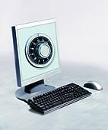
Information Security Awareness
On Behalf of FIPCO
By Ken M. Shaurette

Slide 2
Today’s Agenda
Purpose of Session
Security Threats
Why Information Security is Important
Lets Tell Some Stories
Actions That Make a Difference
How To Protect Yourself

Slide 3
Key Take Away
When you leave here today you will:
Know where to go for security help
Stop cybercriminals from gaining access to <<<< BANK NAME >>>> data and systems
Protect your personal identity
Protect <<<< BANK NAME >>>> staff, customer’s and partner’s private information

Slide 4
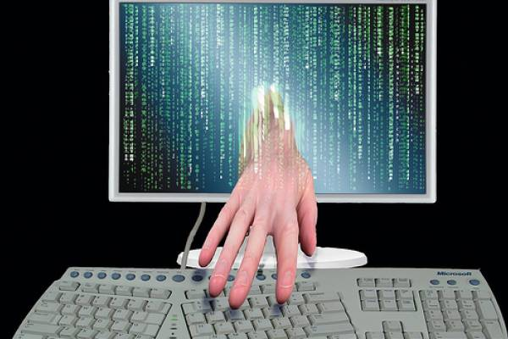
Where the Threat Starts
Hackers and Thief's
Motivated by personal gain
Deception and Technology Tricks
Social Engineering = Persuasion
Look for weak practices to get into places they shouldn’t
Expect people not to be familiar with weak areas of our technology and practices
Anyone have a
person story to
share?

Slide 5
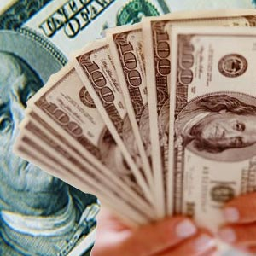
Cyber Criminal Motives
Money
Politics
Personal Recognition
Identity Theft
Knowing They Can

Slide 6
Cybercriminal Motives
According to an article published by YourIdentitySafe, our identities are worth between $.50 to $150 in the Black Market.
http://www.youridentitysafe.com/internet-identity-theft/34what-is-your-identity-worth

Slide 7
PLAY video a this link: http://www.identitytheft.info/criminal.aspx

Slide 8
It’s Worth More
An identity is stolen every 4 seconds in the US.
The average cost to restore a stolen identity is $8,000.
Victims spend an average of 600 hours recovering from this crime.

Slide 9
Cyber Criminal Methods
Review our Web Sites
Search Internet on information about us
Call and email us attempting to trick us
Search for our modems and wireless networks
Read our trash, desktops, and workspace area
Look for weaknesses in our technology
Look for weakness in our change and configuration management practices

Slide 10
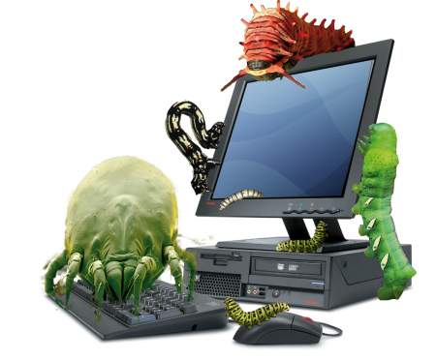
Definitions

Slide 11
Definitions
Spyware
Hardware or software that “spies”, via the Internet, on what the user is doing and captures activity without their knowledge, usually for advertising/marketing purposes. Spyware can also gather information about e-mail addresses, passwords and credit card numbers.
Virus A program that secretly attaches itself to other programs and when executed causes harm to a computer.
Trojan A destructive program that masquerades as a benign application. Unlike viruses, Trojan horses may not replicate themselves but they can be just as destructive. Listening devices.

Slide 12
Definitions (continued)
Worm
A malicious program that does not attached itself to other programs or need user intervention to execute. Intent is to propagate itself. (Code Red, Nimda, Sasser, My Doom)
Firewall An application or hardware device installed either on your pc or between your pc and the internet that allows you to monitor and block unwanted traffic.
Phishing
A recently released Gartner survey reports that 57 million Americans likely have received fraudulent e-mails that appear to be from trusted legitimate businesses and attempt to persuade the recipients to visit bogus websites where phishers can steal their personal information.
Pharming
Similar in nature to e-mail phishing, pharming seeks to obtain personal or private (usually financial related) information through domain spoofing. Rather than being spammed with malicious and mischievous e-mail requests for you to visit spoof Web sites which appear legitimate, pharming 'poisons' a DNS server by infusing false information into the DNS server, resulting in a user's request being redirected elsewhere. Your browser, however will show you are at the correct Web site, which makes pharming a bit more serious and more difficult to detect. Phishing attempts to scam people one at a time with an e-mail while pharming allows the scammers to target large groups of people at one time through domain spoofing.

Slide 13
Why Do We Need Information Security Awareness
To protect staff, customers, and business partners
To protect <<<< BANK NAME >>>> employees from harm
To communicate the best practices for protection
To communicate our position on security and proper information protection
Compliance to GLBA Section 501b Safeguarding Customer Information
Information protection practices are not static – They always change to accomplish overall security goals (Consistent Communication is the Key to Success)

Slide 14
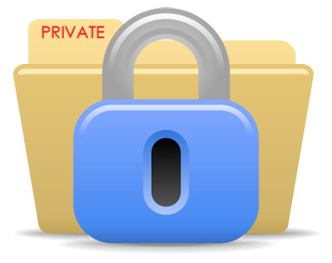
Actions That Make a Difference
Appropriate Use Policy– What you should and shouldn’t do with technology systems (Computers, Laptops, BlackBerry, Cell Phones, Printers)
Security Responsibility – How you can contribute to our success in protecting our information and systems
Password Usage – Ways to protect your password and identity
Internet Usage – Ways you can protect yourself while on the Internet
Email Usage – Ways that you can protect information while using email

Slide 15
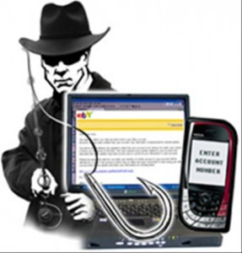
Ways You Can Contribute
Create good “strong” passwords
Do not:
Use <<<< BANK NAME >>>> e-mail ID’s for non-business use
Share accounts and passwords
Protect Yourself on the Internet - Do not:
Open unexpected e-mail attachments, even if they are from someone you know – danger of imposters – phishers
Open attachments of types that are not of common types
Respond to spam, do not “unsubscribe”
Send non-public data through email or other Internet technology unless it is encrypted
Visit Internet sites that could cause systems harm
Install non-credible software from any website

Slide 16
Ways You Can Contribute (Cont)
Guard against being deceived or accidentally disclosing information
Do Not:
Log into unsecured websites (http:// versus https://)
Give Out Personal Information Over the Phone, in email or on web
Ask for personal computer information from another co-worker (There are special circumstances. Verify Requestor)
Let unrecognized guests go without escort
Protect Paper Copies – Do Not:
Throw away non-public information without shredding
Leave unattended for a long period of time
Provide to Third-Party unless approval has been obtained
NOTICE NO HTTPS:

Slide 17
NOTICE HTTPS:
INSERT ON THIS PAGE THE BANKS OWN ONLINE BANKING WEBSITE TO SHOW SECURE LOGIN WITH HTTPS HIGLIGHTED.

Slide 18
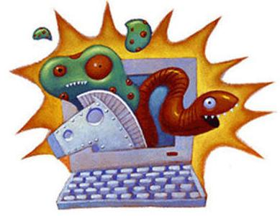
Ways That You Can Contribute (Cont)
Do Not:
Add hardware or software to your systems without approval
Never use someone else's account
Leave your PC without logging out or locking your PC
Use home or personal accounts on <<<< BANK NAME >>>> systems
Protect yourself against loss of productivity, lost data and ID Theft:
Have diskettes and other portable media scanned before use – no non-business media
Back up your data
Use virus protection at all times

Slide 19
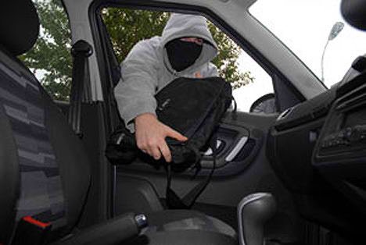
Ways That You Can Contribute When Traveling
Do not store information on portable storage media (USB Drives, MP3 Players, Cell Phones, etc) unless it is encrypted
Do not store sensitive information on your system unless it is encrypted
Keep computer systems in your possession as much as you can
Do not leave computer system in car, Lock in trunk if necessary
Take laptop on plane with you, do not send through baggage
Do not leave computer when in public place
When using public wireless networks, such as airport, library, coffee shop, etc, use VPN client to connect

Slide 20
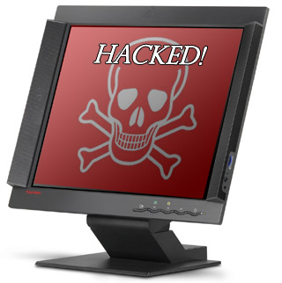
Identify a compromised computer
Slower than usual
A lot of pop-ups even when the browser is not being used
Odd behavior of the data that you work with (file sizes drastically changing, missing files, file names changed)
Mouse cursor moves by itself

Slide 21
Summary
Your knowledge of security risks are important to protecting the organization and you
Your understanding and personal efforts to protect sensitive information makes a difference
Security vulnerabilities will increase over time
Know how to respond and whom you should report security concerns to
Understand information security protection practices are not meant to restrict but to protect!
Learn More; www.identitytheft.info, check out the available videos for your own personal protection!

Slide 22
For Questions Contact FIPCO:
Ken M. Shaurette, CISSP, CRISC, CISA, CISM
(608) 441-1251 or kshaurette@fipco.com
Thank You For Your Time
Remember!
The Data Handling Golden Rule: "Treat all data you work with like it is data about you or your family and you will handle it well!"

